Slide 1

New physics of Early Dark Energy from the Cosmic Birefringence
Lu Yin
Lu Yin, Joby Kochappan, Tuhin Ghosh, Bum-Hoon Lee.
arXiv: 2510.25489 [astro-ph.CO].
PRD 112 (2025) 6, 063562.
JCAP 10 (2023) 007.
Shanghai-APCTP-Sogang-GIST workshop
on Gravity, Astroparticle, and Cosmology (SASGAC 2025)
2025/12/27-2025/12/29
CQUeST, Seoul

Slide 2
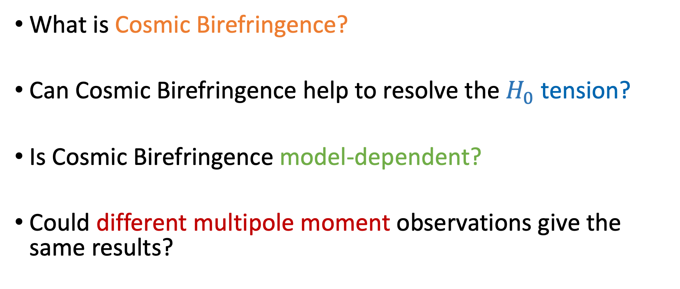
Outline
What is Cosmic Birefringence?
Can Cosmic Birefringence help to resolve the $H_{0}$tension?
Is Cosmic Birefringence model-dependent?
Could different multipole moment observations give the same results?

Slide 3

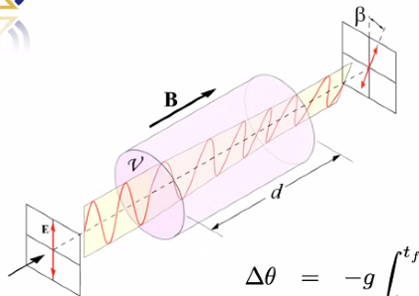
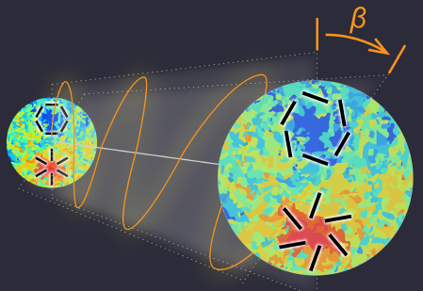


What is Cosmic Birefringence?
The rotation of the plane of linear polarization of photons
WMAP and Planck
J.R.Eskilt, E.Komatsu, PRD 106 (2022) 6

Slide 4

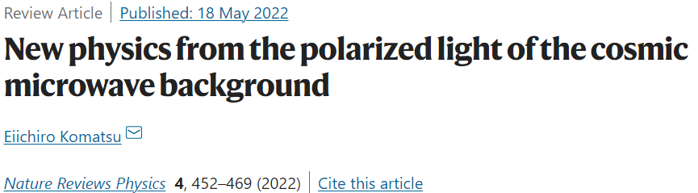

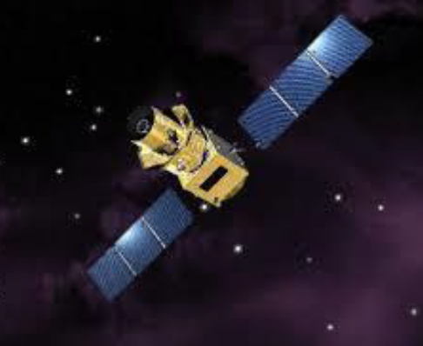
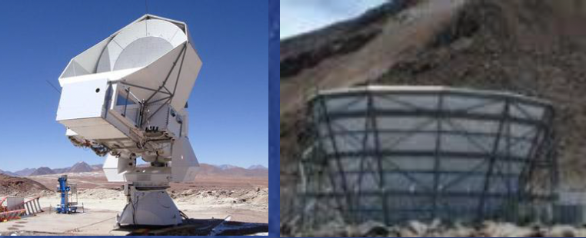
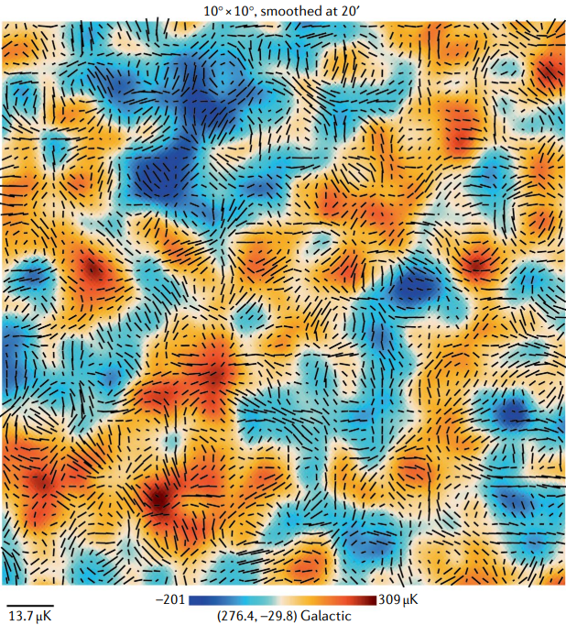
New physics from CMB
LiteBIRD POLARBEAR/SA ACT
Polarized light of the cosmic microwave background (CMB) may hold the answer to these fundamental questions. Two phenomena uncovered:
First, if the physics behind dark matter and dark energy violates parity symmetry, their coupling to photons should have rotated the plane of linear polarization as the CMB photons have been travelling for more than 13 billion years. This effect is known as ‘cosmic birefringence’. A tantalizing hint of such a signal has been found with a statistical significance of 3σ.
Second, the period of accelerated expansion in the very early Universe, called ‘cosmic inflation’, might have produced a stochastic background of primordial gravitational waves.

Slide 5
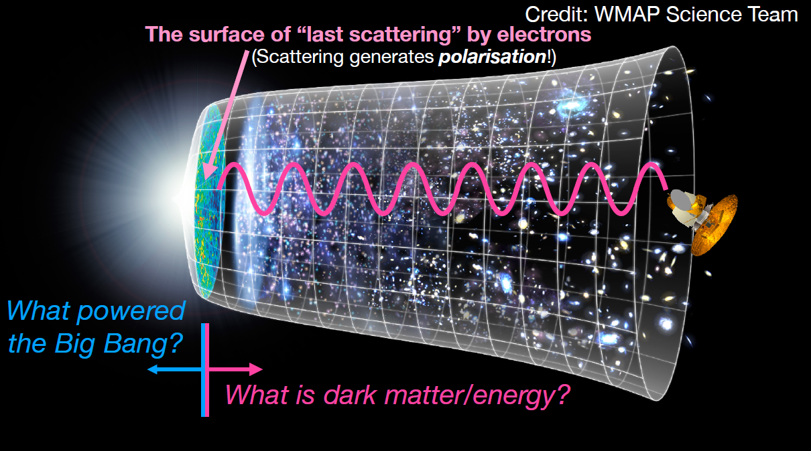

Slide 6
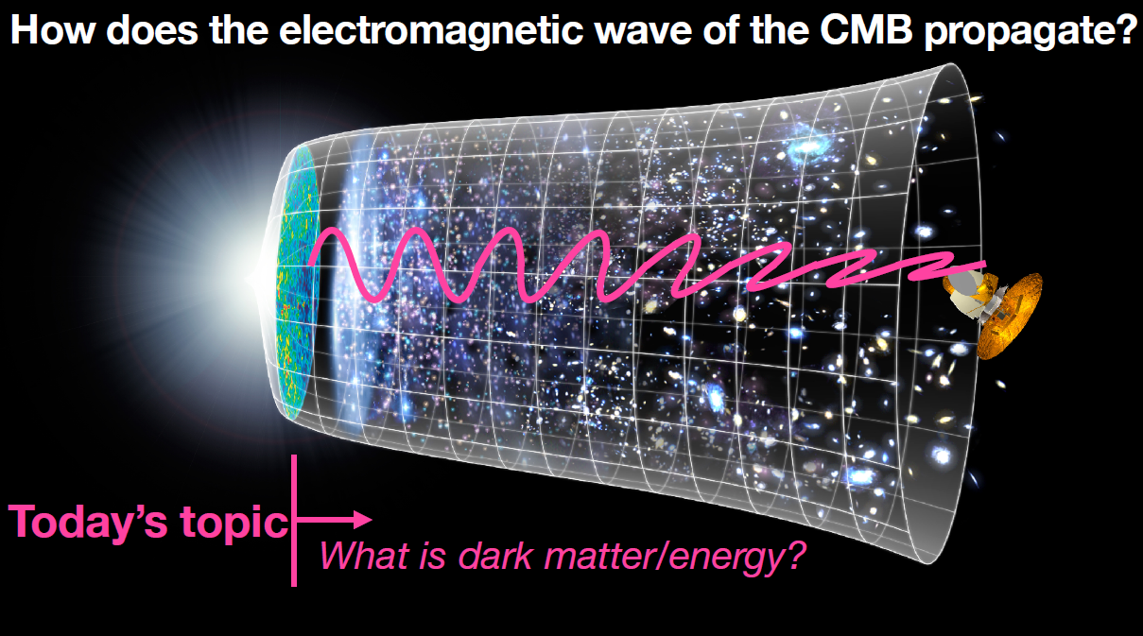

Slide 7
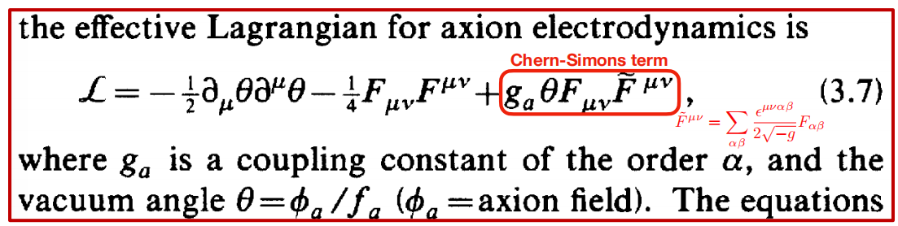
Introduction to Cosmic Birefringence
Cosmic birefringence is a parity-violating phenomenon, which might indicate the new physics beyond the standard cosmology (ꓥCDM).
Traditional explanation involves an axion coupled to the EM tensor via a Chern-Simons coupling.
The axion can be dark matter or dark energy, which act as a “birefringence material” filling in our Universe
Ni (1977); Turner & Widrow (1988)

Slide 8

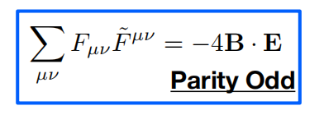
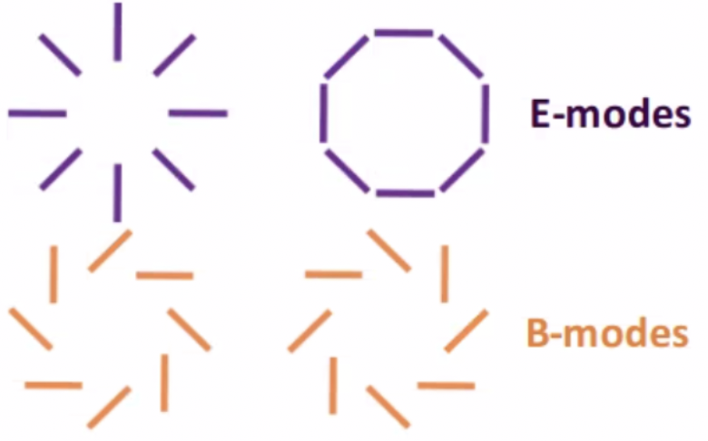
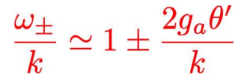
Introduction to Cosmic Birefringence
The Equation of Motion modified to
Different phase velocities for RH(+) and LH(-) photon polarizations

Slide 9
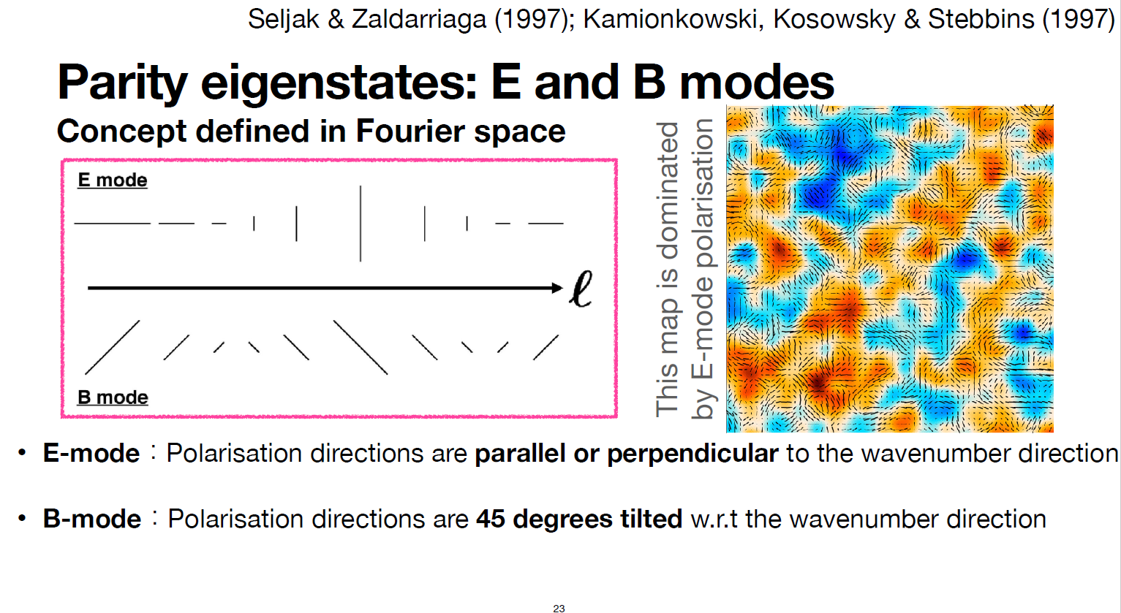
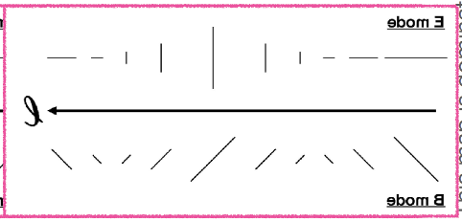
Introduction to Cosmic Birefringence
The Equation of Motion modified to
Different phase velocities for RH(+) and LH(-) photon polarizations

Slide 10
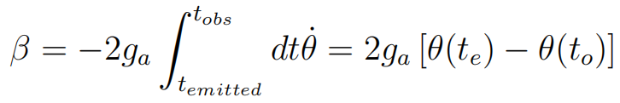
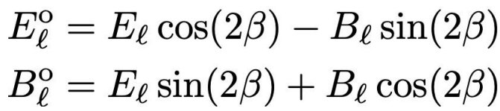



Introduction to Cosmic Birefringence
CB rotation angle
E-B mixing by rotation of the linear polarization plane in CMB

Slide 11
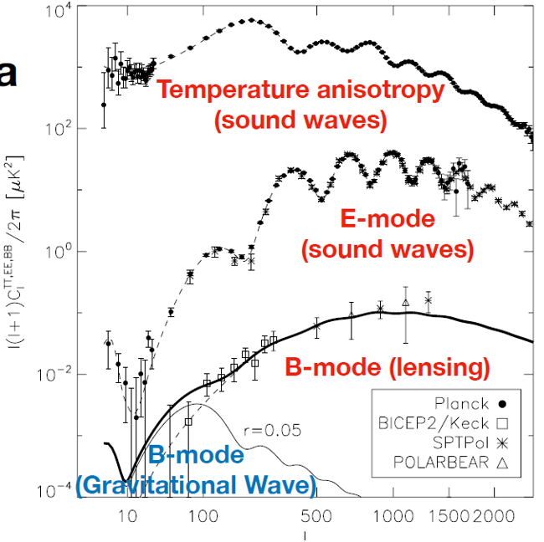


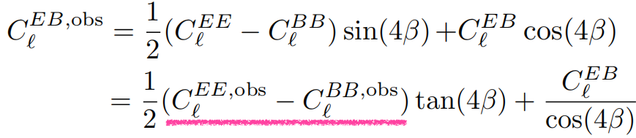
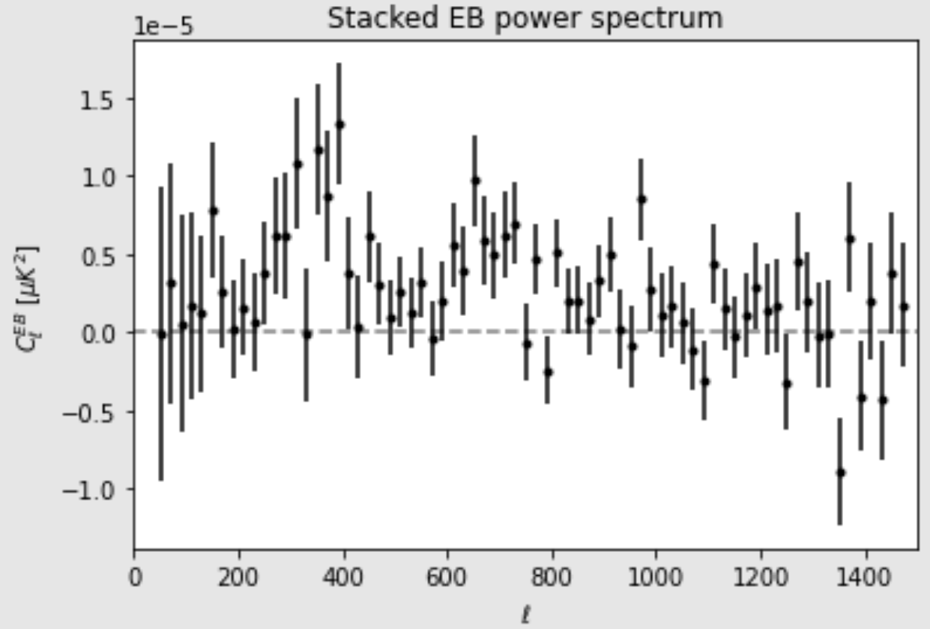

Cosmic Birefringence in the CMB
<E*B> correlation measures
EB is generated by the difference between EE and BB spectra
Observed EB Power Spectrum of the High Frequency Instrument of Planck
If = 0, the
J. R. Eskilt et al. (2023)
Planck Collaboration Int. LVII,
Astron. Astrophys. 643, A42 (2020)

Slide 12


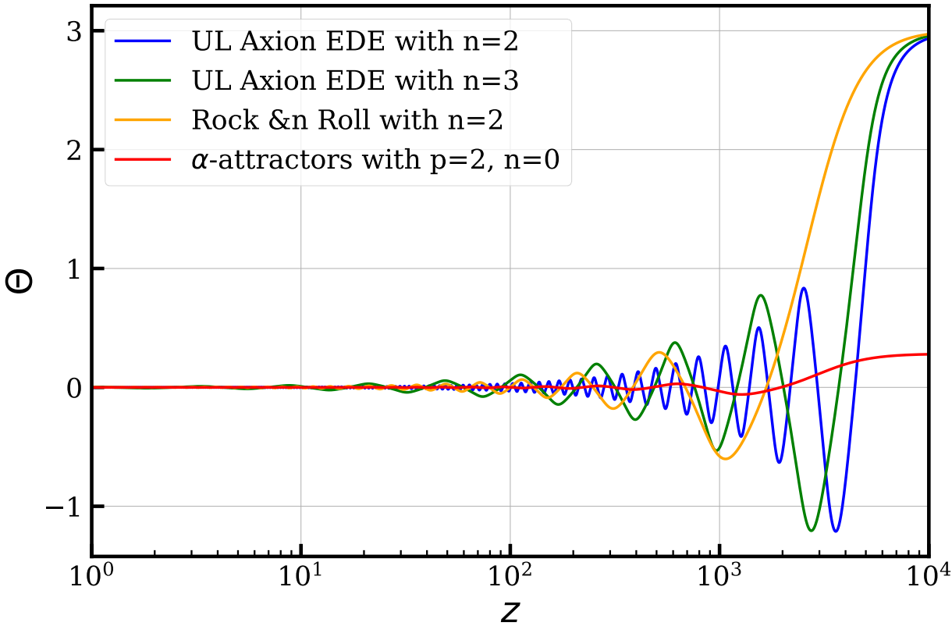
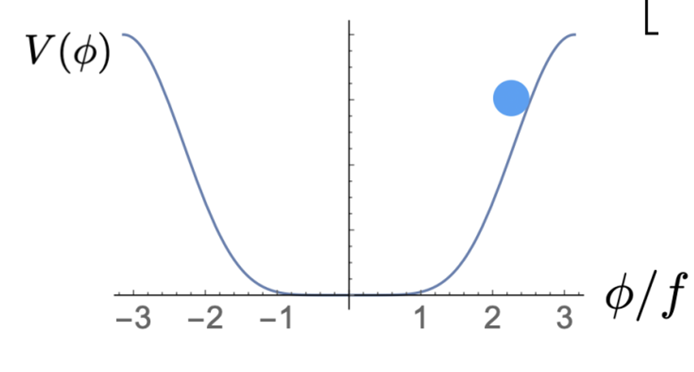
Cosmic Birefrigence from Early Dark Energy
The pseudoscalar fields of early dark energy
EDE

Slide 13
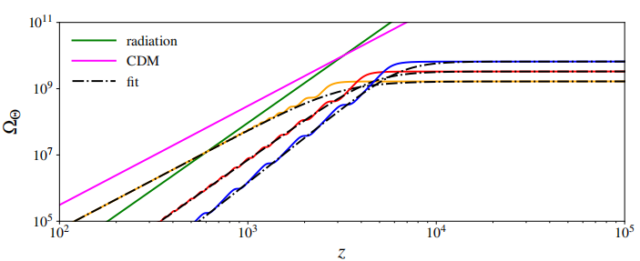
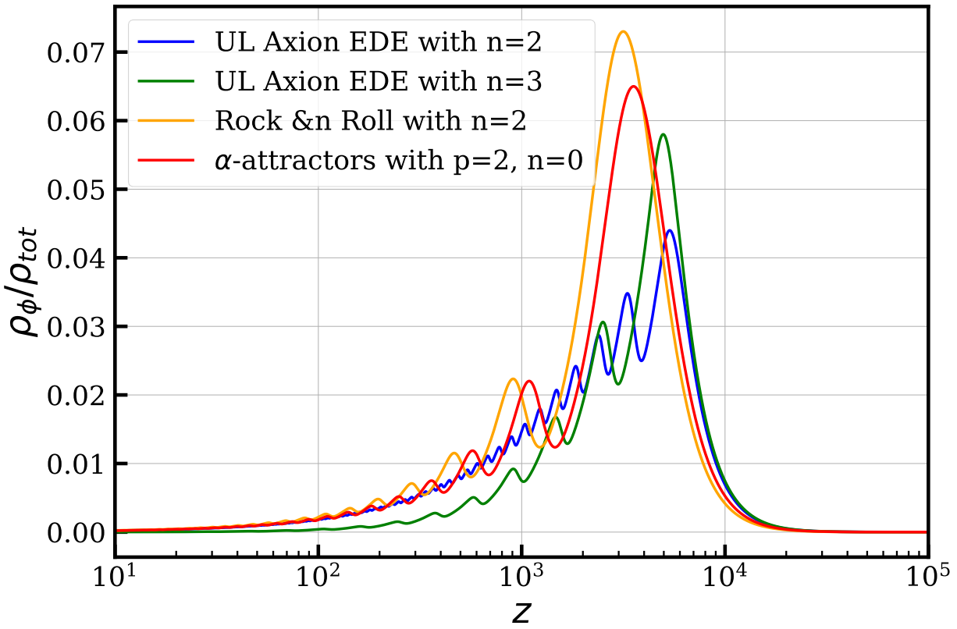



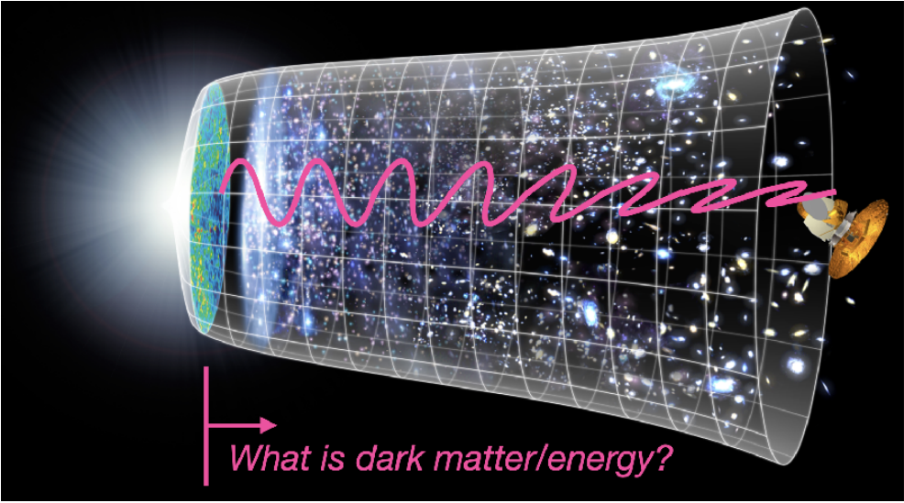
Cosmic Birefringence from Early Dark Energy
Early Dark Energy Model
CMB
Last scattering surface

Slide 14
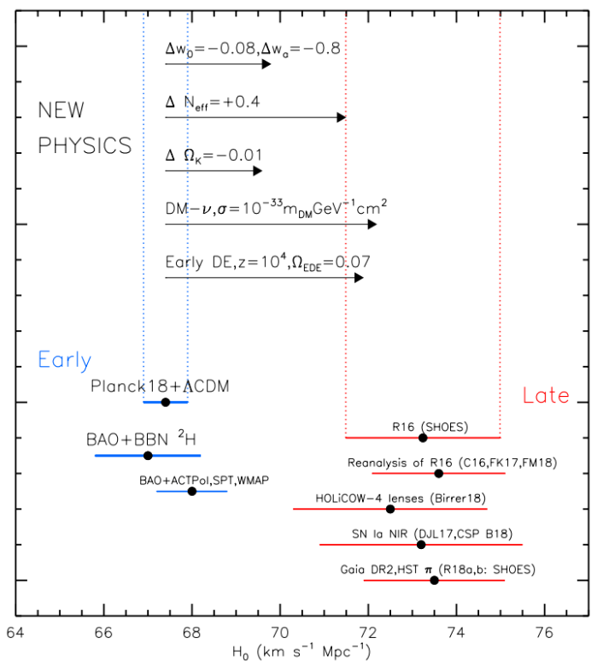
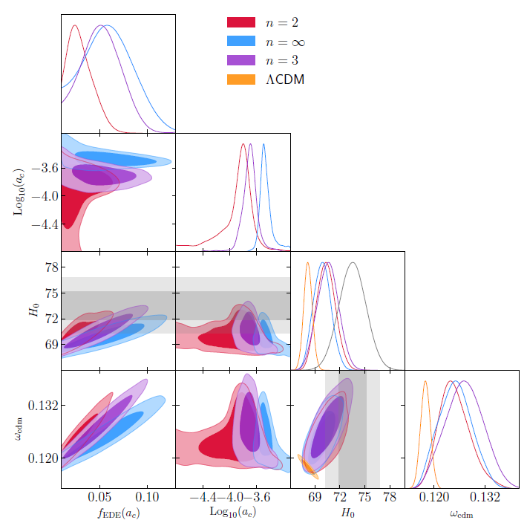
EDE is an effective model to solve the H0 tension

Slide 15
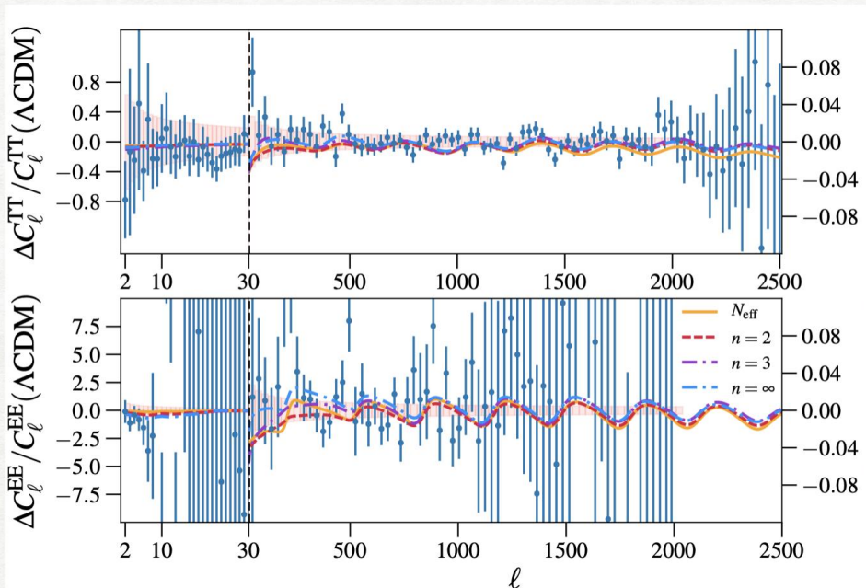
EDE fitted well with CMB
Phys.Rev.Lett. 122 (2019) 22, 221301

Slide 16
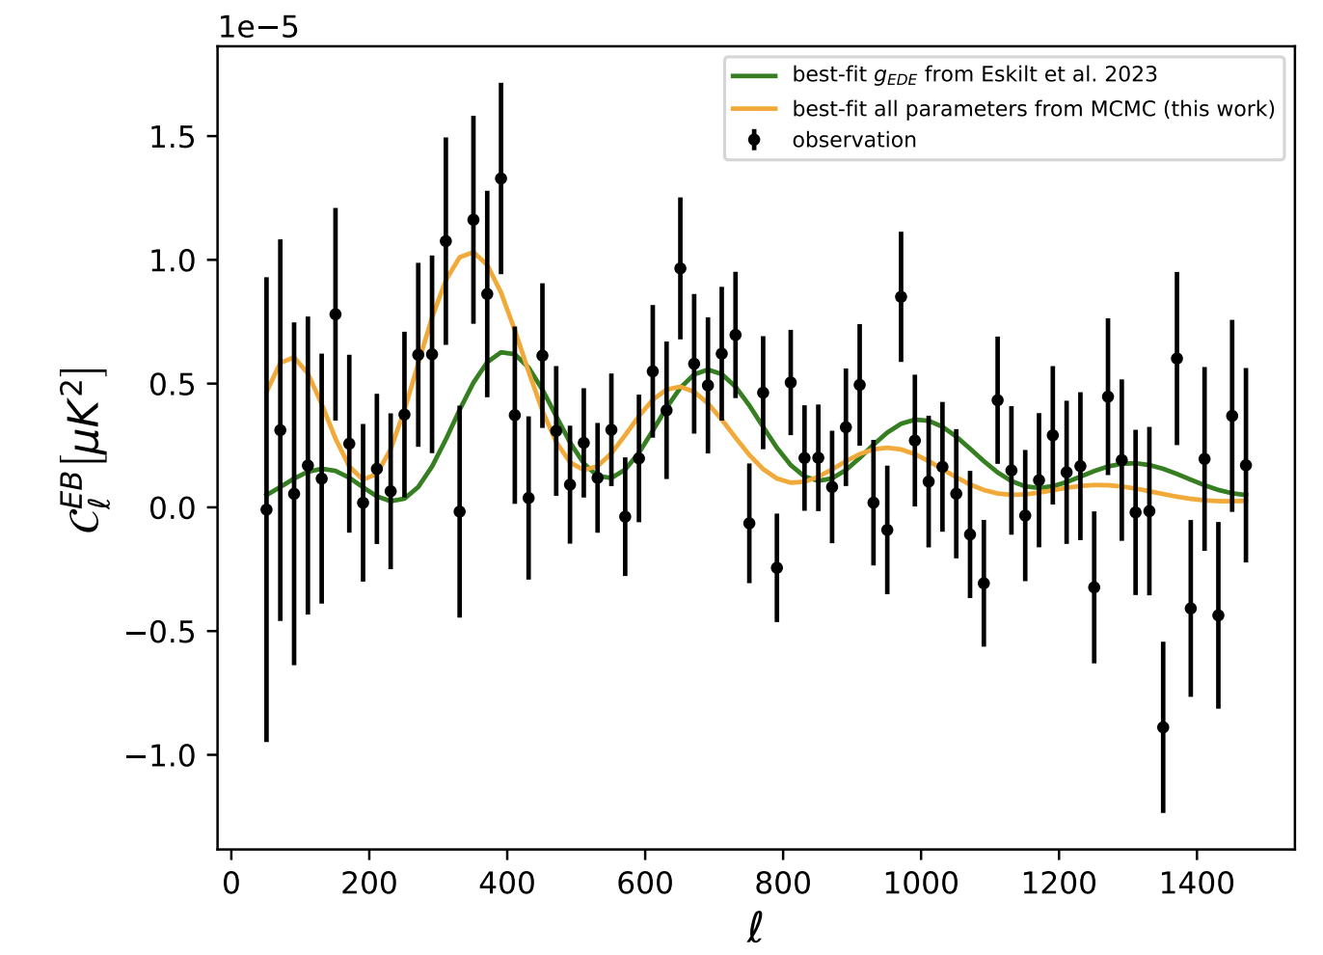
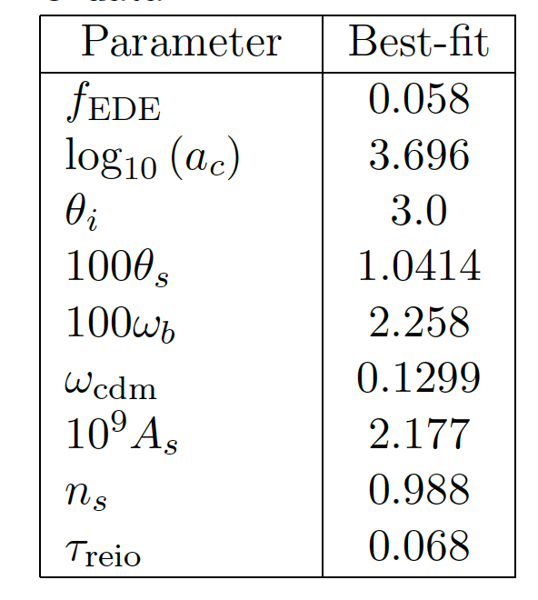

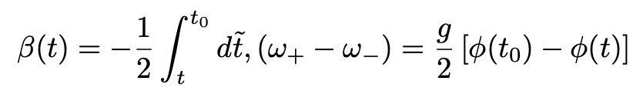
Can Cosmic Birefringence help to resolve the $H_{0}$ tension?
g_EDE = 0.1483
g_EDE = 0.549
The best-fit result of EDE parameters with TT, TE, EE, BAO, SN data.
The orange line is result of fit all the parameters with TT, TE, EE, EB, BAO, SN data.
The green line is result only fit g_EDE with EB data, other parameters are fixed from right hand table.
[PRD 112 (2025) 6, 063562.]

Slide 17
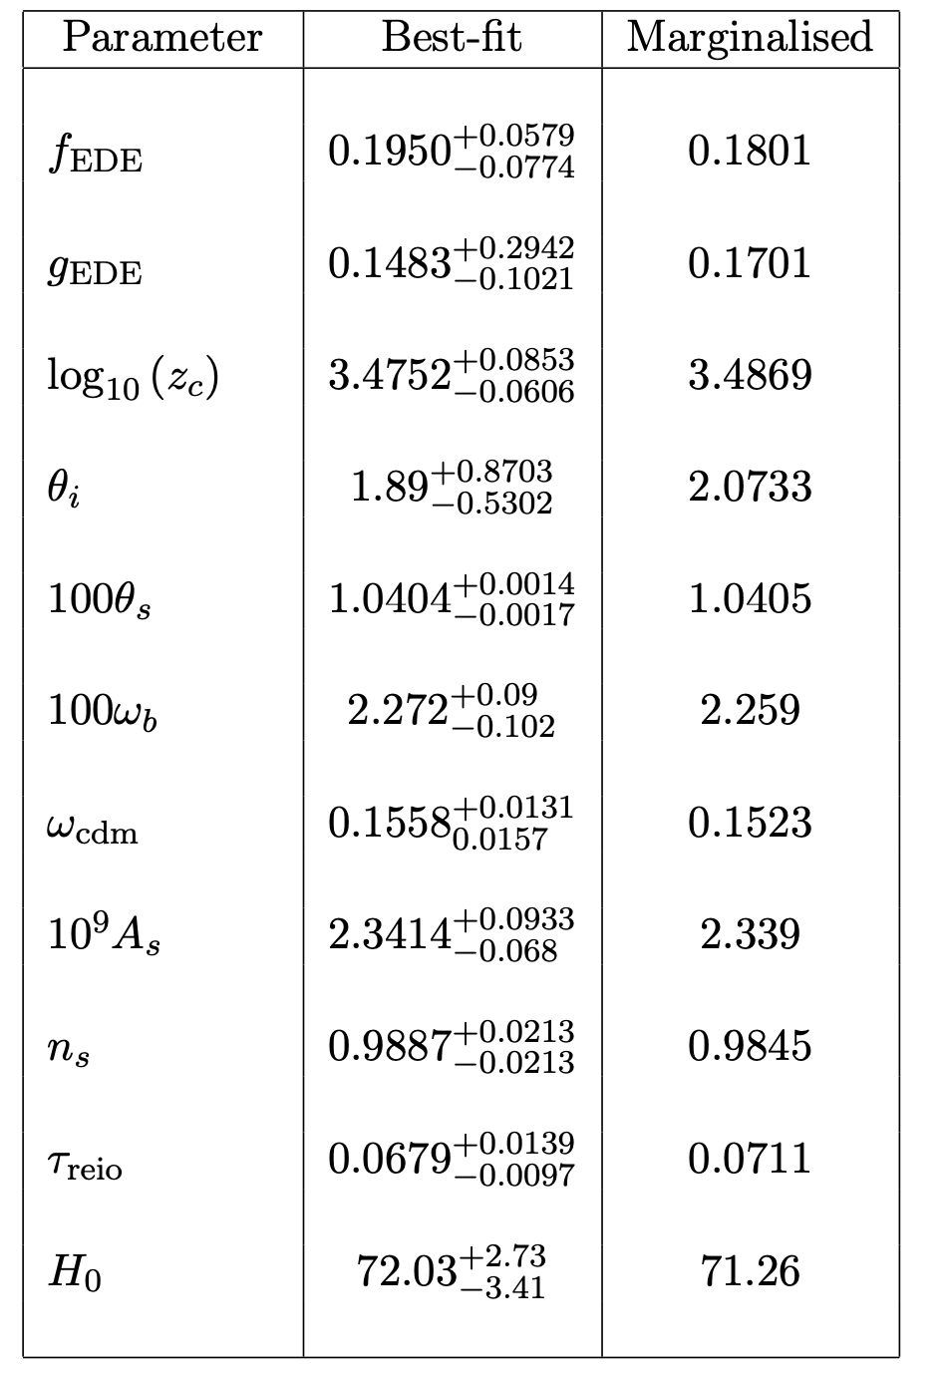
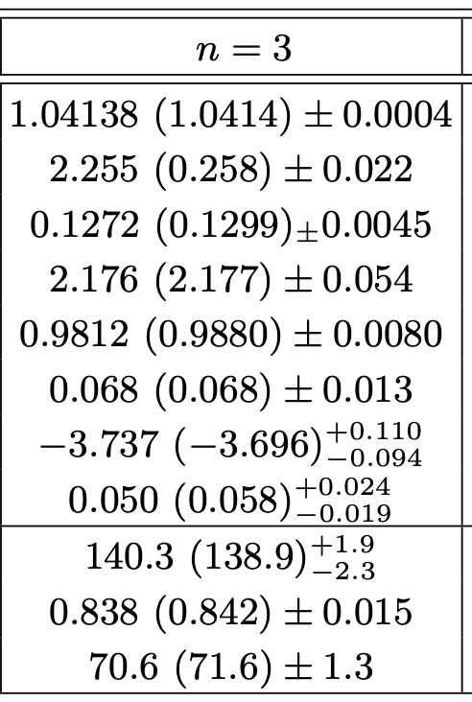
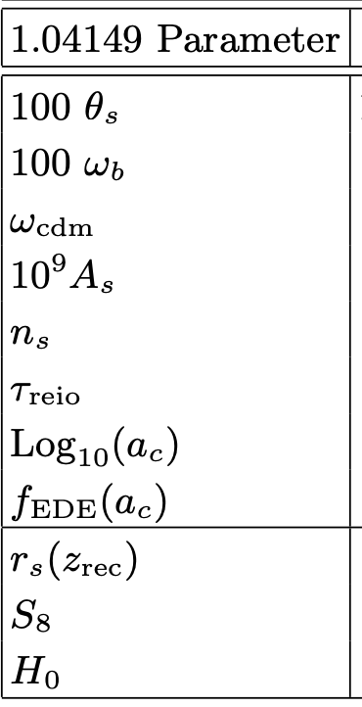
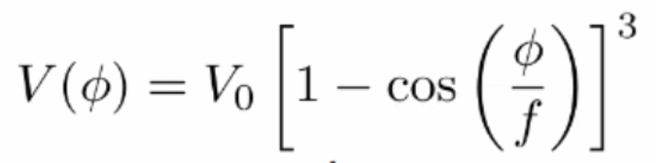
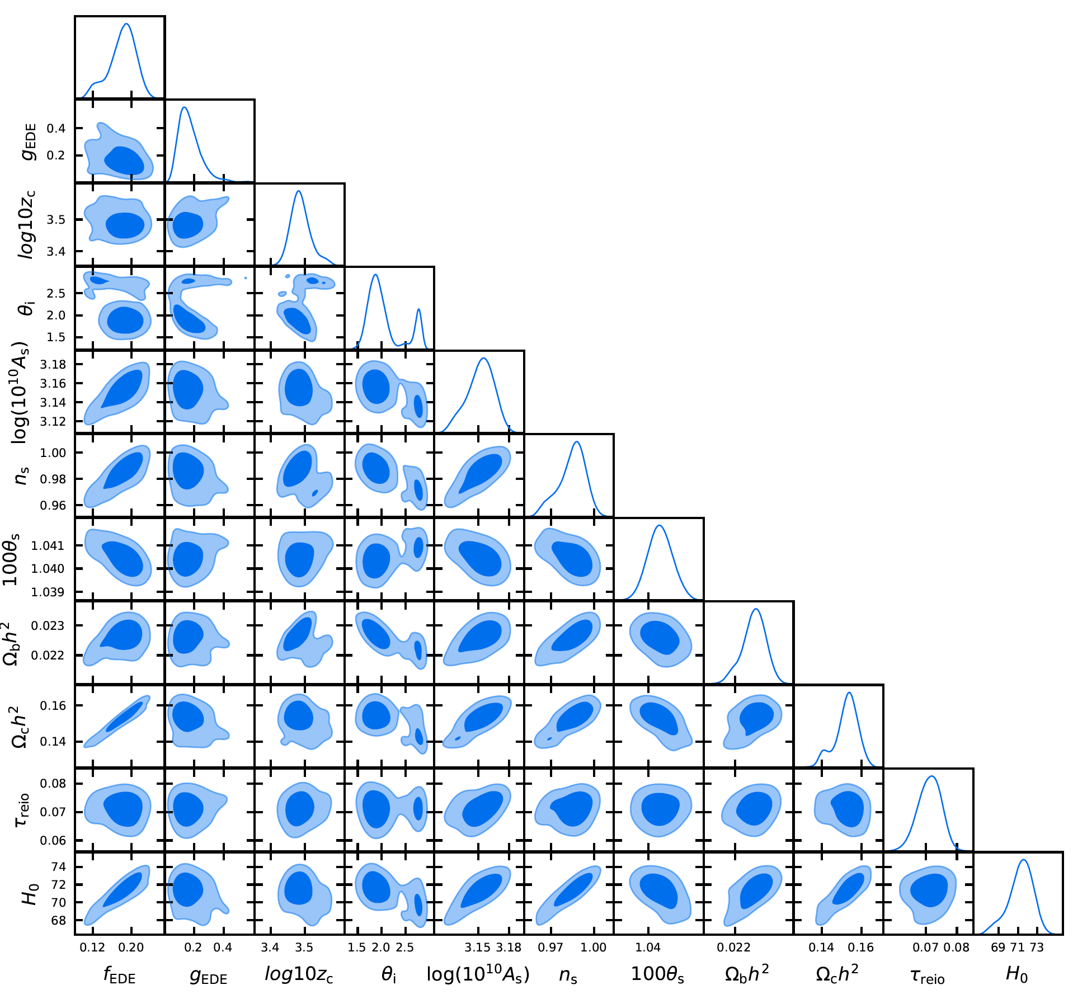
Can Cosmic Birefringence help to resolve the $H_{0}$ tension?
The pseudoscalar fields of early dark energy
V. Poulin et al. (2018)
V. Poulin et al. Phys.Rev.Lett. 122 (2019) 22, 221301
Our work fit EDE with TT, TE, EE, EB, BAO, SN [PRD 112 (2025) 6, 063562.]
With considering EB data and Cosmic Birefringence effect,
the EDE with n=3 get higher value of H0.

Slide 18
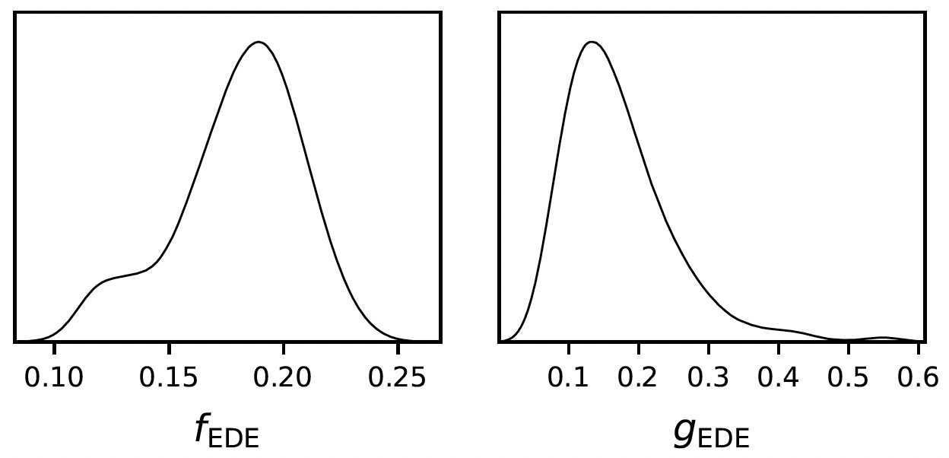
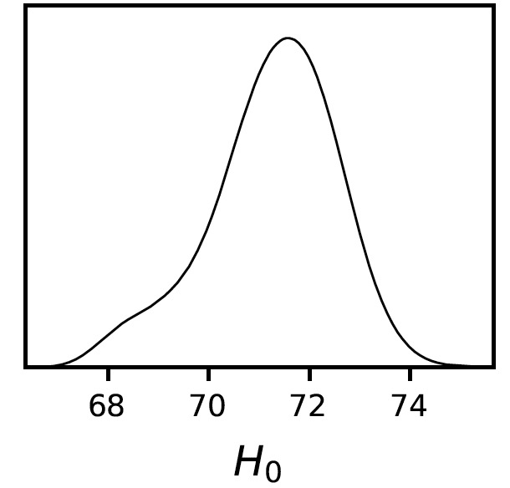
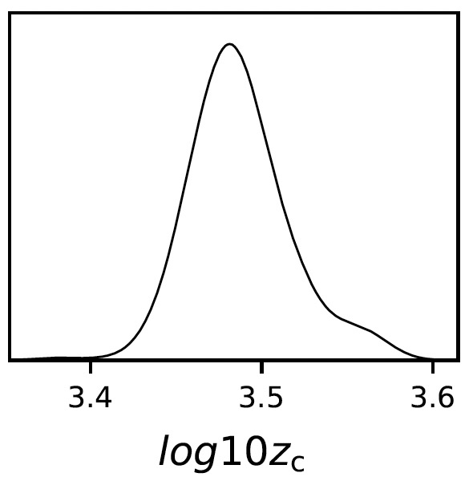
Can Cosmic Birefringence help to resolve the $H_{0}$ tension?
V. Poulin et al. Phys.Rev.Lett. 122 (2019) 22, 221301
Our work fit EDE with TT, TE, EE, EB, BAO, SN [PRD 112 (2025) 6, 063562.]
With considering EB data and Cosmic Birefringence effect, the EDE with n=3 get higher value of H0.

Slide 19
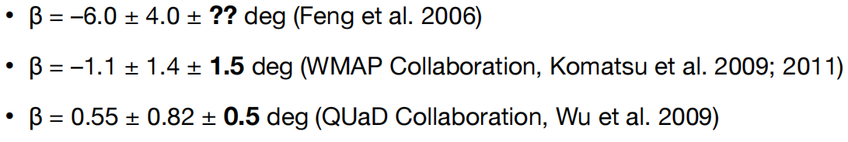
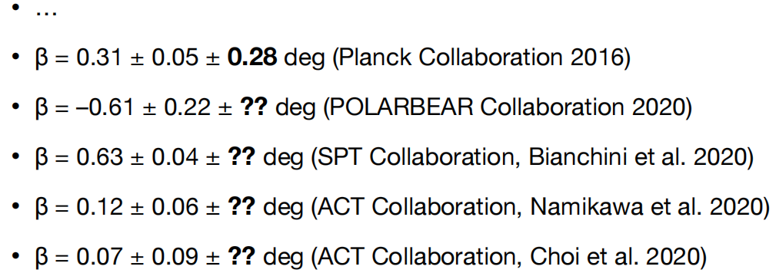
The past measurements
Now including the estimated systematic errors on α

Slide 20

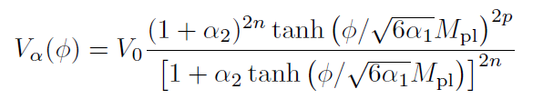

Cosmic Birefrigence from Early Dark Energy
The pseudoscalar fields of early dark energy
EDE
Early Dark Energy model Rock ‘n’ Roll model -attractor model
V. Poulin et al. (2018)
P. Agrawal et al.(2019)
M. Braglia et al. (2020)

Slide 21
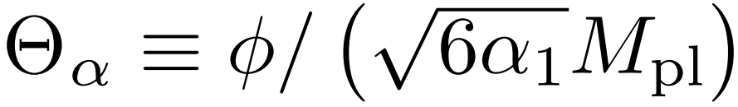


Cosmic Birefringence from Early Dark Energy
The pseudoscalar fields of early dark energy
EDE
$$θ=φ/f$$
$$θ=φ/M_{pl}$$

Slide 22

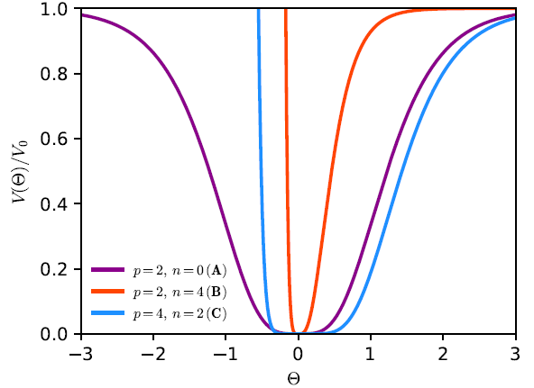

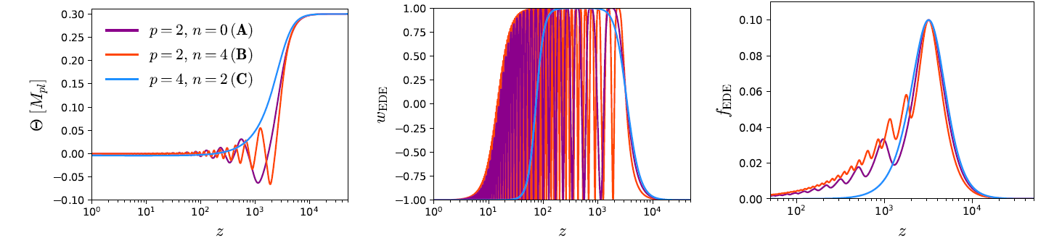
Early Dark Energy from -attractors

Slide 23
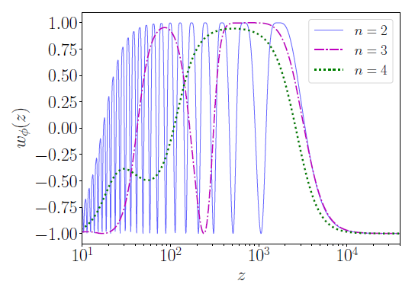
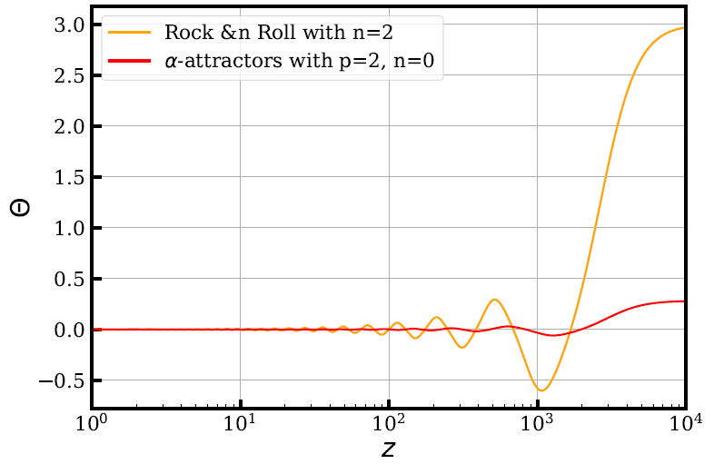
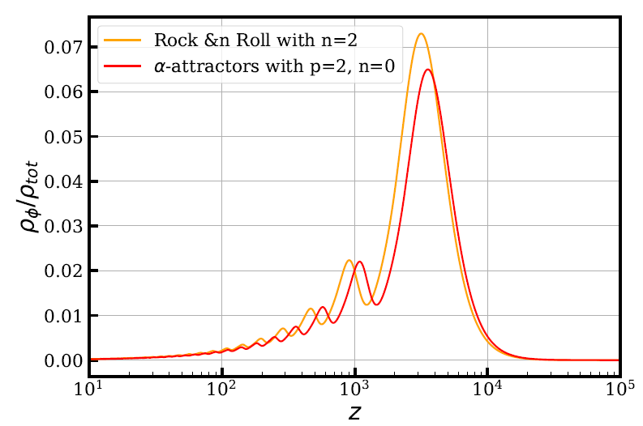
Rock `n' Roll model

Slide 24
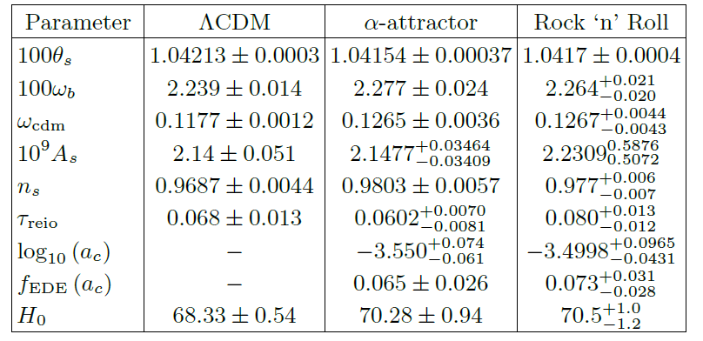
Rock `n' Roll model alpha-attractors

Slide 25
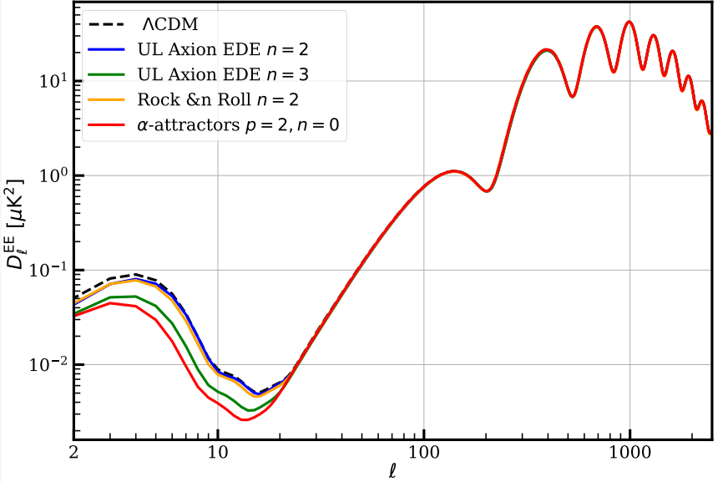



Difference in EE and EB power spectra
gM_Pl=1
new term

Slide 26

Difference in EE and EB power spectra
gM_Pl=1
EB power spectra is an important smoking gun for different early dark energy models, beyond the EE spectra

Slide 27


Best fit results form Planck observation
gM_Pl=1
1. value of Chern-Simons term is model-dependent
2. current data can not distinguish the two models

Slide 28




Best fit results form Planck observation
axion-like Early Dark Energy
Our work

Slide 29


The rotation of the plane results from best fit of g
The value of g is model dependent.
Moreover, the rotation angle β is also highly model dependent.

Slide 30








EB BB
The Cosmic Birefringence from different multipole moment observations
SPIDER Planck ACT

Slide 31



The Cosmic Birefringence from different multipole moment observations
Planck+BOSS, Planck+BOSS+SH0ES, Planck_EB+Planck+BOSS+SH0ES
Probability To Exceed (PTE) to evaluate the quality of the fit to the data.

Slide 32

The Cosmic Birefringence from different multipole moment observations
Planck+BOSS, Planck+BOSS+SH0ES, Planck_EB+Planck+BOSS+SH0ES

Slide 33


The Cosmic Birefringence from different multipole moment observations

Slide 34





The past measurements
Measured of
?

Slide 35



Model-independent analysis in terms of the total effective rotation angle α+β
?

Slide 36


α + β > 0 is 0.51σ, 9.67σ, 4.75σ, and 1.73σ, respectively α + β > 0 is 9.67σ, 4.75σ, 7.0σ, and 7.3σ, respectively
Model-independent analysis in terms of the total effective rotation angle α+β

Slide 37

Conclusions
Cosmic Birefringence is a remarkable parity-violating effect, which is beyond the standard cosmology prediction; new breakthrough in CMB data analysis leads to β = 0.34 ± 0.09 deg (68%CL; nearly full sky).
EB dataset can help to resolve the $H_{0}$ tension in EDE model.
We studied EB mode of Rock `n' Roll, and -attractor scalar models for the first time. The value of g is model dependent. Moreover, the rotation angle β is also highly model dependent.
We also find that ACT data alone do not provide sufficiently tight constraints on either g or α + β, whereas the combination Planck+ACT improves the results and leads to a better PTE.
Thank you

Slide 38
Current research related to Cosmic Birefringence
Removal the miscalibration of polarization angles
[J.R.Eskilt, et al. PRD 106 (2022) 6, J.R.Eskilt, et al. PRL (2023)]
Anisotropic of Cosmic Birefringence
[T. Namikawa PRD 109 (2024), B. Sherwin, et al. MNRAS 520 (2023) 3]
Implications for ALPs from cosmic birefringence
[D. Zhang Phys.Rev.D 110 (2024) 10]
Ambiguity of phase of measured rotation angle
[F. Naokawa, et al. 2405.15538]
Birefringence and Gravitational Waves
[R. Ferreira, et al. JCAP 05 (2024) 066]
?

