Slide 1
Generating Cosmological Anisotropies
*arXiv:2209.15225
Bum-Hoon Lee^{ab}, Hocheol Lee^{ab}, Wonwoo Leeª, Nils A. Nilsson^{c}, Somyadip Thakur^{d}
2023 Workshop on Cosmology and Quantum Spacetime
임채호 교수님 추모 학회
August 03, 2023
Hocheol Lee (Sogang Univ.)
a: Center for Quantum Spacetime, Sogang University
b: Department of Physics, Sogang University
c: SYRTE, Observatoire de Paris, Universite PSL, CNRS, Sorbonne Universite
d: Department of physics, Hanyang University
Notes:
Hello, everyone. I am Hocheol Lee from Sogang university. First of all, I would like to say thank for all the efforts to organize this conference. Today’s my talk title is generating cosmological anisotropies. This work collaborated with professor Bum-Hoon Lee and doctor Wonwoo Lee, Nils A. Nilsson and Somyadip Thakur.

Slide 2
Overview & Goal
$$S=\int{d^{4}x\sqrt{−g}\left(\frac{R−2Λ}{2κ}−\frac{1}{2}∇_{μ}φ∇^{μ}φ−V\left(φ\right)−\frac{1}{4}F_{μν}F^{μν}−\frac{Θφ}{4}F_{μν}{\tilde{F}}^{μν}+𝓛_{m}\right)}$$
$φ^{4}$Potential
Maxwell Term
Matter
Axion Pseudoscalar Field
${φ \& \tilde{F}}^{μν}$ Coupled Term
Einstein Gravity &
Cosmological Constant
$$ds^{2}=−dt^{2}+e^{2α^{\left(0\right)}}\left[e^{2εβ_{1}^{(1)}}dx_{1}^{2}+e^{2εβ_{2}^{(1)}}\left(dx_{2}^{2}+dx_{3}^{2}\right)\right]$$
Notes:
Let me jump all the details just for a while. As a overview and goal of this work, we used this action and this metric function. The first term of action is Einstein gravity and cosmological constant, the second term is an axion pseudoscalar field, the third term is a phi 4 potential, the fourth term is a Maxwell term, which is literally gives Maxwell equations, the fifth term is phi and dual field coupled term, and the last term is a Lagrangian for matter. We also used this metric function. There is a overall factor e to the 2 alpha and individual factors e to the 2 epsilon beta 1 and beta 2. The beta 1 and beta 2 split the space
and epsilon time betas are small perturbation. If betas are zero, then it will be a FLRW metric. I will talk about more later.

Slide 3
Success of ΛCDM Model
Cosmic Microwave Background
Plank Finds Isotropy Up to ${10}^{−5}$ Order
Baryon Acoustic Oscillator
Large Scale Distribution of Galaxies
Large Scale Structure
Cosmic Web Simulation Matches ΛCDM Model
FLRW: $ds^{2}=−dt^{2}+a(t)\left(dx^{2}+dy^{2}+dz^{2}\right)$
The Universe is Homogeneous and Isotropy on Large Scale
Notes:
First, I would like to shortly introduce the success of LCDM model. There are 3 big successes. One is the cosmic microwave background. The Plank finds the isotropy up to 10 to the –5 order. Another one is baryonic acoustic oscillator which is well represents the large scale distribution of galaxies. The other one is the large scale structure. The cosmic web simulation matches to LCDM model. The success of LCDM model directly connected to homogeneity and isotropy of universe which is described with FLRW metric. Therefore, we can easily accept the cosmological principle. From now on, let us focus on the isotropy. What if universe is not isotropic?

Slide 4
What If?
Cosmic No-Hair Theorem:
*R. M. Wald Phys. Rev. D 28 (1983)
“Any Anisotropic Homogeneous Bianchi Spacetime Always will be an Isotropic and de Sitter Space”
Anisotropy
$$t$$
$$H_{0} \sim t_{H}^{−1} \sim 10^{−18}s$$
Notes:
The answer is the Wald’s cosmic no-hair theorem. Any anisotropic homogeneous Bianchi spacetime always will be an isotropic and de Sitter space. Or else you may just look at this graph. The longitudinal axis represents the amount of anisotropy and horizontal axis shows the time. Even if spacetime has the anisotropy at the beginning, it will decay very fast and spacetime will recover the isotropy. The decay time is proportional to reverse of Hubble time, about 10 to the -18 second. It is a very short time compare to the age of the universe. So, is it happy end for isotropic universe?

Slide 5
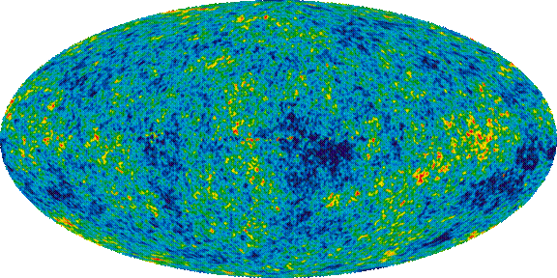
Cosmic Microwave Background
*Planck (2013)
$−2.5μ$K
$2.5μ$K
Notes:
This is a cosmic microwave background map from Planck 2013. Globally it is a same temperature, but there is a very small, about 10 to the -6 order of anisotropies exist on the CMB map.

Slide 6
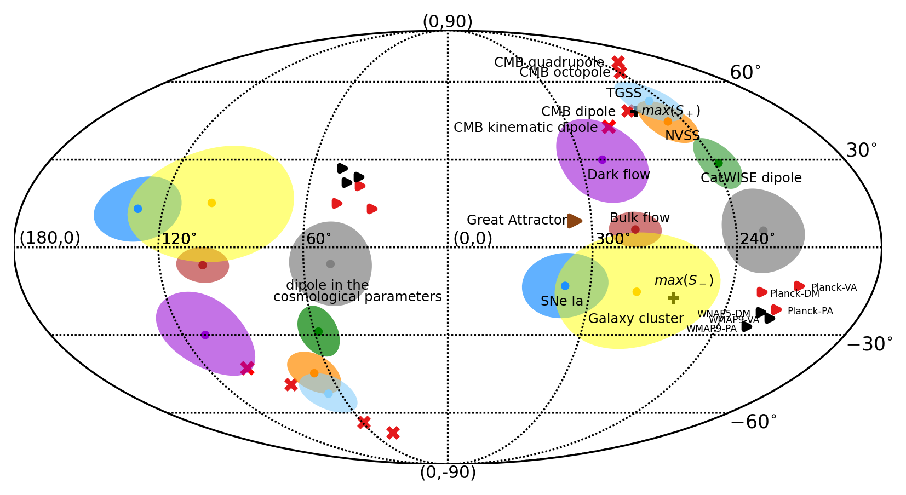
Directions of Anisotropy
*P. K. Aluri et al., arXiv: 2207.05765 (2022)
Notes:
This figure shows the directions of anisotropy in the universe. I don’t know the whole thing exactly, but you can see some arrows, great attractor, bulk flow, CMB dipole, octupole, quadrupole and so on.

Slide 7
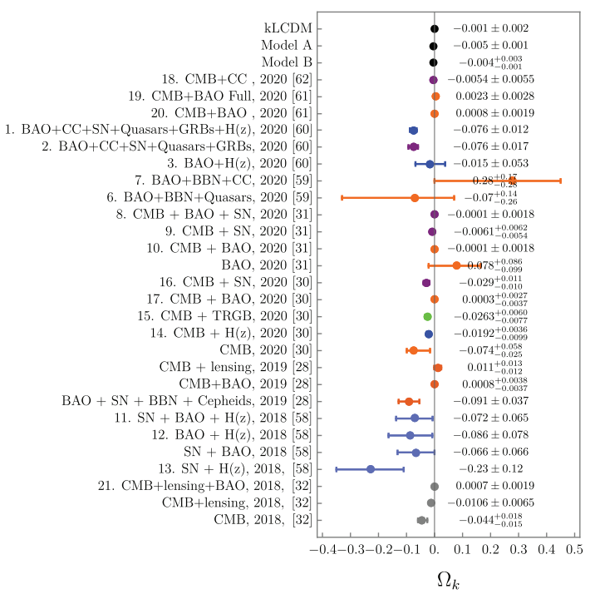
Flatness Problem
*N. A. Nilsson, Mu-In Park Eur. Phys. J. C 82 (2022)
Notes:
In LCDM model, we expect that universe is flat. A lot of data confirm that universe is flat, but especially, the blue dots, which contain the supernova, are quite far from the 0.

Slide 8
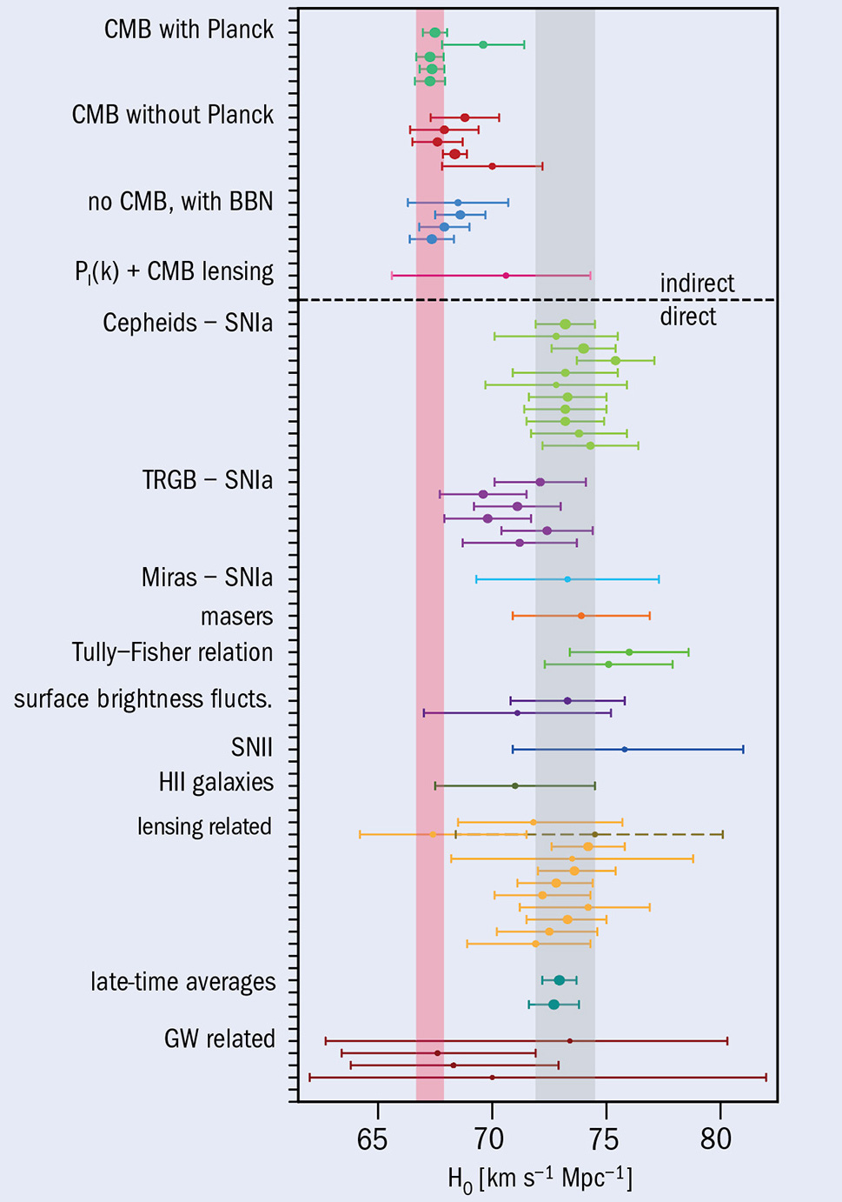
Hubble Tension
Quadrupole-Octopole Alignment
Anomalous Bulk Flow
Radio-Galaxy Dipoles
Variation of Fine-Structure Constant
Cosmic Birefingence
*A. Oliveira-Costa et al., Phys. Rev. D 69 (2004)
*C. Howlett et al., Mon. Not. Roy. Astron. Soc. 515 (2022)
*D. J. Schwarz et al., Phy. Rev. Lett. 93 (2004)
*J. A. King et al., Mon. Not. Roy. Astron. Soc. 422 (2012)
Rotation of the Polarisation Plane of CMB Photons
*E. Komastsu Nature Rev. Phys. 4 (2022)
*E. D. Valentino et al., Class. Quant. Grav. 38 (2021)
Notes:
Next is a Hubble constant. The Hubble constant from CMB data converge to the red band about 67 and the Hubble constant from supernova data converge to the gray band about 73. The gap of those two line is called Hubble tension. The right side is a cherry pick for candidate of Hubble tension. Quadrupole-octopole, alignment, anomalous bulk flow, radio-galaxy dipoles, variation of fine-structure constant, and cosmic birefringence. Among them, we focused on the last, cosmic birefringence.

Slide 9
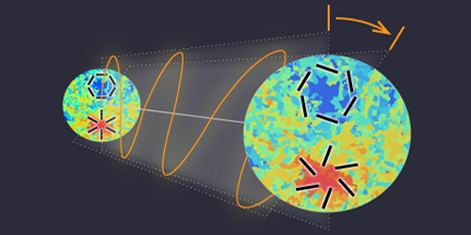
Cosmic Birefingence
Cosmic Birefingence Reported at ~ $3σ$
$β=0.35±0.14$ Degrees
Axion Electrodynamics Chern-Simon Term: $ℒ \sim ΘφF_{μν}{\tilde{F}}^{μν}$
$$β$$
*Y. Minami et al., Phys. Rev. Lett. 125 (2020)
*P. D. Palazuelos et al., Phys. Rev. Lett. 128 (2022)
*Yuto Minani
Notes:
As a name implies, the dark matter or dark energy acts like crystal, so it causes the cosmic version of birefringence. Therefore, the polarization of CMB photon rotates after move around the universe. It is reported at 3 sigma, and the rotation angel is 0.35 degree. Those are can be reproduced by axion electrodynamics Chern-Simon term, which is phi and dual field are coupled.

Slide 10
Main Motivation
Cosmic No-Hair Theorem:
“Isotropic and Homogeneous is an Attractor of the Cosmic Evolution”
No need to be start from Isotropic Universe
No need to be the attractor is in a Very Early Time
Cosmic No-Hair Theorem
Our Model
Anisotropy
Anisotropy
$$+e^{2εβ}$$
$$+ ΘφF_{μν}{\tilde{F}}^{μν}$$
$$t_{0}$$
$$t$$
$$t$$
Notes:
Go back to the cosmic no-hair theorem and let’s rephrase like this. Isotropic and homogeneous is an attractor of the cosmic evolution. I agree with that but there are two points to note. The universe is no need to be start from isotropy and attractor is no need to be a very early time. The left one is the cosmic no-hair theorem, the anisotropy decays very fast. The right one is our model. The anisotropy also decays but slower then left. As a observation result, some anisotropies still remain in present universe. In our model, we expect also small amount of anisotropies due to the e to the epsilon beta and phi-dual field coupled term. At the end, anisotropy will fade out in future.

Slide 11
Model
$$S=\int{d^{4}x\sqrt{−g}\left(\frac{R−2Λ}{2κ}−\frac{1}{2}∇_{μ}φ∇^{μ}φ−V\left(φ\right)−\frac{1}{4}F_{μν}F^{μν}−\frac{Θφ}{4}F_{μν}{\tilde{F}}^{μν}+𝓛_{m}\right)}$$
Action:
Metric Function:
$$ds^{2}=−dt^{2}+e^{2α^{\left(0\right)}}\left(e^{2β_{1}}dx_{1}^{2}+e^{2β_{2}}dx_{2}^{2}+e^{2β_{3}}dx_{3}^{2}\right)$$
$$R_{μν}−\frac{1}{2}Rg_{μν}+Λg_{μν}=κ\left(T_{μν}^{PF}+{\tilde{T}}_{μν}^{AN}\right)$$
Einstein Equation:
Energy Momentum Tensor
From Anisotropies:
$$=∇_{μ}φ∇_{ν}φ−\frac{1}{2}g_{μν}∇_{α}φ∇^{α}φ−g_{μν}V\left(φ\right)−\frac{1}{4}g_{μν}F_{αβ}F^{αβ}$$
$${\tilde{T}}_{μν}^{AN}$$
$$+F_{μ}^{α}F_{να}$$
$$0=□φ−V^{′}\left(φ\right)−\frac{Θ}{2}ε^{αβδρ}∇_{β}A_{α}∇_{ρ}A_{δ}$$
Equation of Motion for $φ$:
Equation of Motion for $A$:
$$0=□A_{μ}−∇^{α}∇_{μ}A_{α}−Θε_{αβδμ}\left(∇^{β}A^{α}∇^{δ}φ+φ∇^{δ}∇^{β}A^{α}\right)$$
Notes:
Now we are in main stage. We will find that how betas and phi-dual field effect to anisotrpies. Start with the most general metric function as known as Bianchi type 1. We can just derive the equation of motion from the action blindly. Therefore, there are Einstein equation, energy momentum tensor from anisotropies, equation of motion for phi and gauge field.

Slide 12
Gauge Field & Geometry Connection
Align the Gauge Field $A_{μ}$ with the Killing Directions of Bianchi Type VII₀:
$$ds^{2}=−dt^{2}+e^{2α^{\left(0\right)}}\left[e^{2εβ_{1}^{(1)}}dx_{1}^{2}+e^{2εβ_{2}^{(1)}}\left(dx_{2}^{2}+dx_{3}^{2}\right)\right]$$
$$K_{i}=∂_{i}$$
$$\left(i=2, 3\right)$$
$$K_{1}=∂_{i}−x_{2}∂_{3}−x_{3}∂_{2}$$
$$ℒ_{K_{i}}g^{μν}=0$$
$$ℒ_{K_{i}}F^{μν}=d\left(iK_{i}F\right)+iK_{i}dF$$
$$dF=0$$
$$ℒ_{K_{i}}F=0$$
$F^{μν}$ is Only the Function of Time
Same Analysis for $A_{μ}$
Notes:
The next is a choosing gauge field. Under the constraints from the Killing equation and do some algebraic calculation, the 2-form gauge field F is a only the function of time.
After do the same procedure with 1-form gauge field A, A is also the function of time. (More precisely, we selected the Bianchi type 70 for our purpose. It looks same as the Bianchi type I apparently, but the one of big difference is that the Bianchi type I has 4 killing vectors and the Bianchi type 70 has 3 killing vectors.)

Slide 13
Equations of Motion
Bianchi Type VII₀:
$$ds^{2}=−dt^{2}+e^{2α}\left(e^{2β_{1}}dx_{1}^{2}+e^{2β_{2}}dx_{2}^{2}+e^{2β_{3}}dx_{3}^{2}\right)$$
$$\left(β_{2}=β_{3}\right)$$
$$A_{μ}=\left\{\begin{aligned}0 \\ ψ_{i}e^{α+β_{i}}\end{aligned}\right.$$
$$\left(μ=0\right)$$
From the Killing Eq.:
$$\left(μ=i\right)$$
$$0=\ddot{φ}+\dot{φ}\left(3\dot{α}+\sum_{n}{{\dot{β}}_{n}}\right)+V^{′}\left(φ\right)$$
EOM for $φ$:
$$0={\ddot{ψ}}_{i}+\left[{\dot{ψ}}_{i}+ψ_{i}\left(\dot{α}+{\dot{β}}_{i}\right)\right]\left(3\dot{α}+\sum_{n}{{\dot{β}}_{n}}\right)+ψ_{i}\left[\ddot{α}+\ddot{β}−{\left(\dot{α}+{\dot{β}}_{i}\right)}^{2}\right]$$
EOM for $A$:
EMT From Anisotropies:
$$=3{\dot{α}}^{2}+2\dot{α}\sum_{n}{{\dot{β}}_{n}}+{\dot{β}}_{1}{\dot{β}}_{2}+{\dot{β}}_{2}{\dot{β}}_{3}+{\dot{β}}_{3}{\dot{β}}_{1}$$
$$−\frac{1}{2}\sum_{n}{{\left[{\dot{ψ}}_{n}+ψ_{n}\left(\dot{α}+{\dot{β}}_{n}\right)\right]}^{2}}−\frac{1}{2}{\dot{φ}}^{2}−V\left(φ\right)$$
$${\tilde{T}}_{00}^{PF}+Λ$$
Notes:
As I mentioned previous page, we chose the Bianchi type 70 and temporal U(1) gauge field. As a result we have a one overall scale factor, alpha, and two individual scale factor, beta 1 and beta 2. With given metric function and gauge field, the equation of motion reduce as follows. One of the interesting point is there is no Theta in the equations.

Slide 14
Where is the Θ?
$$0=□φ−V^{′}\left(φ\right)−\frac{Θ}{2}ε^{αβδρ}∇_{β}A_{α}∇_{ρ}A_{δ}$$
$$0=□A_{μ}−∇^{α}∇_{μ}A_{α}−Θε_{αβδμ}\left(∇^{β}A^{α}∇^{δ}φ+φ∇^{δ}∇^{β}A^{α}\right)$$
$$ε^{αβδρ}∇_{β}A_{α}∇_{ρ}A_{δ}$$
$$=−\left(∂_{t}A_{i}\right)ε^{tiδρ}∇_{ρ}A_{δ}$$
$$=−\left(∂_{t}A_{i}\right)ε^{tijk}Γ_{jk}^{ℓ}A_{ℓ}$$
$$=0$$
Or . . .
$$\int{d^{4}x\sqrt{−g}ΘF_{μν}{\tilde{F}}^{μν}}=\int{d^{4}x\sqrt{−g}\frac{1}{\sqrt{−g}}{\tilde{ε}}^{μνδρ}ΘF_{μν}F_{δρ}=\int{d^{4}x {\tilde{ε}}^{μνδρ}ΘF_{μν}F_{δρ}}}$$
Since $A$ is a function of time, only the $F_{0i}$ is non-zero.
Notes:
Due to the temporal gauge and levi-civita tensor, mechanically we can calculate the theta term and show is a genuinely 0 as follows. Another way to show is that the dual field has inverse of determinant. As a result, the determinant of metric is canceled out and the remain term doesn’t have a metric part. Therefore, the theta term does not appear in the equations at any level.

Slide 15
Decomposing Gauge Field
$$ψ_{1}=\frac{ψ}{σ^{2}−γ^{2}}$$
$$A_{μ}=\left\{\begin{aligned}0 \\ ψ_{i}e^{α+β_{i}}\end{aligned}\right.$$
$$\left(μ=0\right)$$
$$ψ_{2}=\left(σ+γ\right)ψ$$
$$\left(μ=i\right)$$
$$ψ_{3}=\left(σ−γ\right)ψ$$
Isotropic Conditions:
$${\dot{β}}_{i}=0,$$
$$ψ=0,$$
$$σ=±1,$$
$$γ=0$$
Notes:
Now, decompose the gauge field for simplicity. The sigma and gamma both are scalar function, To recover the isotropy at the end, Those are isotropic conditions.

Slide 16
Perturbation
Perturbation:
$$ξ\left(t\right)=ξ^{(0)}\left(t\right)+εξ^{(1)}\left(t\right)$$
$$α=α^{(0)}$$
$$β_{i}=εβ_{i}^{(1)}$$
$$ψ=ψ^{(0)}+εψ^{(1)}$$
$$φ=φ^{(0)}+εφ^{(1)}$$
$$σ=1+εσ^{(1)}$$
$$ds^{2}=−dt^{2}+e^{2α^{(0)}}\left(e^{2εβ_{1}^{(1)}}dx_{1}^{2}+e^{2εβ_{2}^{(1)}}dx_{2}^{2}+e^{2εβ_{2}^{(1)}}dx_{3}^{2}\right)$$
Notes:
Now, we will give a perturbation for all functions by expanding around the homogeneous and isotropic fixed point. As a result the every scalar field will have a zeroth order and first order. Accept the alpha and beta because alpha and beta give one factor by combine together. Only the alpha has zeroth order and beta has first order, then we can form the metric function as we want.

Slide 17
Perfect Fluid Stress-Energy Tensor
$$T_{μν}^{PF}= \left(\begin{matrix}ρ & \begin{matrix}0 & 0 & 0\end{matrix} \\ \begin{matrix}0 \\ 0 \\ 0\end{matrix} & \begin{matrix} & & \\ & g_{ij}p & \\ & & \end{matrix}\end{matrix}\right), ρ=\sum_{i}{ρ_{i}}, p=\sum_{i}{w_{i}p_{i}}$$
Anisotropy Corrections for $T_{μν}^{PF}$:
$$ρ_{i}=ρ_{i}^{0}e^{−\left(1+w_{i}\right)\left[3α+ε\left(β_{1}^{(1)}+2β_{2}^{(1)}\right)\right]}$$
$$T_{μν}^{PF}=\left\{\begin{aligned} 3H_{0}^{2}\left(Ω_{r}^{0}e^{−4α}+Ω_{m}^{0}e^{−3α}+Ω_{Λ}^{0}\right) \\ 3H_{0}^{2}e^{2α}\left(\frac{1}{3}Ω_{r}^{0}e^{−4α}−Ω_{Λ}^{0}\right)\end{aligned}\right.$$
Isotropic Limit:
Notes:
Due to the perturbation, the perfect fluid also affected.

Slide 18
Perturbed Equations of Motion
$$0={\ddot{φ}}^{(0)}+3\dot{α}{\dot{φ}}^{(0)}+V^{′}\left(φ^{(0)}\right)+𝓞\left(ε\right)$$
$$0={\ddot{ψ}}^{(0)}+3\dot{α}{\dot{ψ}}^{(0)}+\left({\ddot{α}}^{(0)}+2{\left({\dot{α}}^{\left(0\right)}\right)}^{2}\right){\dot{ψ}}^{\left(0\right)}+𝓞\left(ε\right)$$
$$T_{00}^{PF, (0)}+εT_{00}^{PF, (1)}$$
$$=3{\left({\dot{α}}^{\left(0\right)}\right)}^{2}−\frac{3}{2} {\left({\dot{ψ}}^{\left(0\right)}+ψ^{\left(0\right)}{\dot{α}}^{\left(0\right)}\right)}^{2}−\frac{1}{2}{\left(φ^{\left(0\right)}\right)}^{2}−V^{′}\left(φ^{\left(0\right)}\right)+𝓞(ε)$$
$$T_{11}^{PF, (0)}+εT_{11}^{PF, (1)}$$
$$=−e^{2α^{(0)}}\left[2{\ddot{α}}^{(0)}+3{\left({\dot{α}}^{\left(0\right)}\right)}^{2}+{\left({\dot{ψ}}^{\left(0\right)}+{\dot{α}}^{\left(0\right)}ψ^{\left(0\right)}\right)}^{2}+\frac{1}{2}{\left({\dot{φ}}^{(0)}\right)}^{2}−V\left(φ^{(0)}\right)\right]+𝓞(ε)$$
$$V\left(φ\right)=V_{0}{\left(φ^{\left(0\right)}\right)}^{4}+ε\left(4V_{0}{\left(φ^{\left(0\right)}\right)}^{3}φ^{(1)}\right)$$
Notes:
Those are final equations. What we did is solve zeroth order and first order separately.

Slide 19
Parameters & Boundary Conditions
0th
1st
Boundary Conditions
$$α^{(0)}$$
$$β_{i}^{(1)}$$
$t_{f}=$20 Gyr
$t_{0}=13.7$ Gyr
Metric Function
$$α^{\left(0\right)}\left(t_{f}\right)=1.6$$
$$φ^{\left(0\right)}\left(t_{f}\right)=10^{−6}$$
$$ψ^{\left(0\right)}\left(t_{f}\right)=10^{−6}$$
$$φ^{(0)}$$
$$φ^{(1)}$$
$${\dot{φ}}^{\left(0\right)}\left(t_{f}\right)=10^{−6}$$
Scalar field
$$φ^{\left(1\right)}\left(t_{f}\right)=10^{−6}$$
$$ψ^{\left(1\right)}\left(t_{f}\right)=10^{−6}$$
$$σ^{\left(1\right)}\left(t_{f}\right)=10^{−3}$$
$$ψ^{(1)}$$
$$ψ^{(0)}$$
$${\dot{φ}}^{\left(1\right)}\left(t_{f}\right)=−10^{−6}$$
$${\dot{ψ}}^{\left(1\right)}\left(t_{f}\right)=−10^{−6}$$
$${\dot{σ}}^{\left(1\right)}\left(t_{f}\right)=−10^{−3}$$
Gauge Field
$$β_{1}^{\left(1\right)}\left(t_{f}\right)=10^{−6}$$
$$β_{2}^{\left(1\right)}\left(t_{f}\right)=10^{−6}$$
$${\dot{β}}_{1}^{\left(1\right)}\left(t_{f}\right)=−10^{−6}$$
$$σ^{(1)}$$
Notes:
To sum up, There are 3 zeroth order parameters and 4 first
order parameters. Those are the objects to find the profile by
solving the equations. The right side is a boundary condition.
We set the boundary condition at 20 Gyr as future and
the present time is 13.7 Gyr.

Slide 20
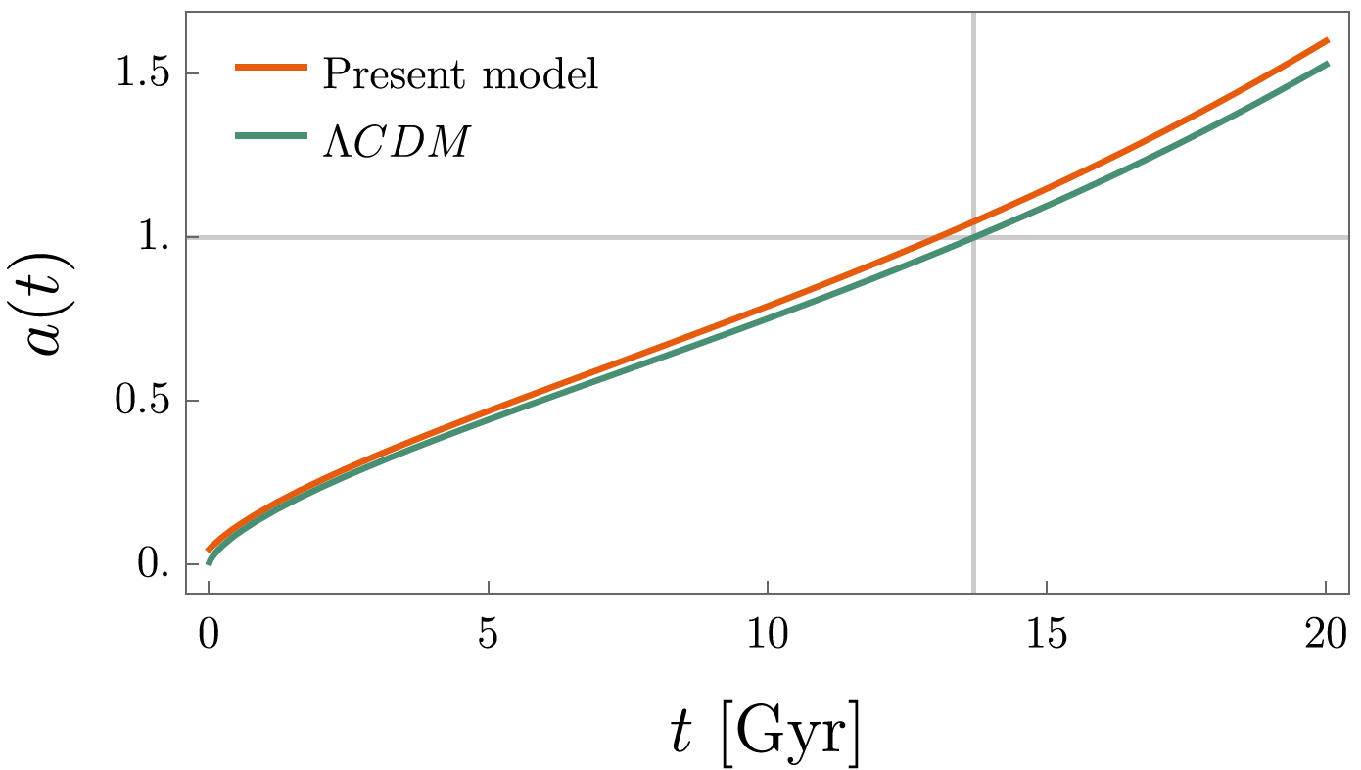
Results
Notes:
This is a graph of scale factor. In our case the scale factor is
e to the alpha. Our model is slightly bigger than LCDM model.

Slide 21
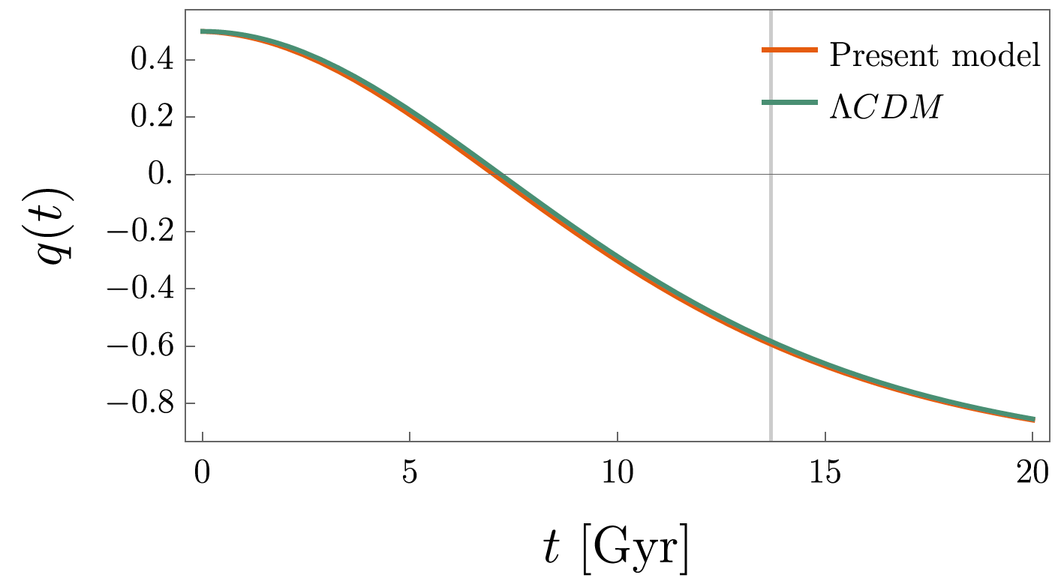
Results
$$q=\frac{\ddot{a}a}{{\dot{a}}^{2}}$$
Deceleration Parameter:
Notes:
This is a deceleration parameter. Due to the scale factor,
the deceleration parameter is smaller than LCDM model.
It means our model has shorter accelerating expansion period.

Slide 22
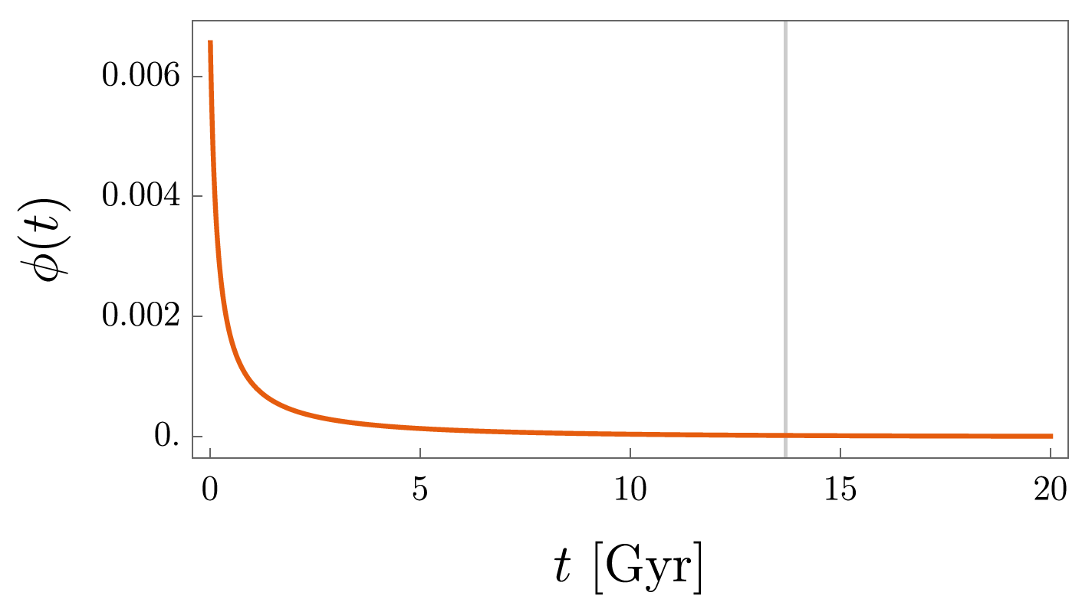
Results

Slide 23
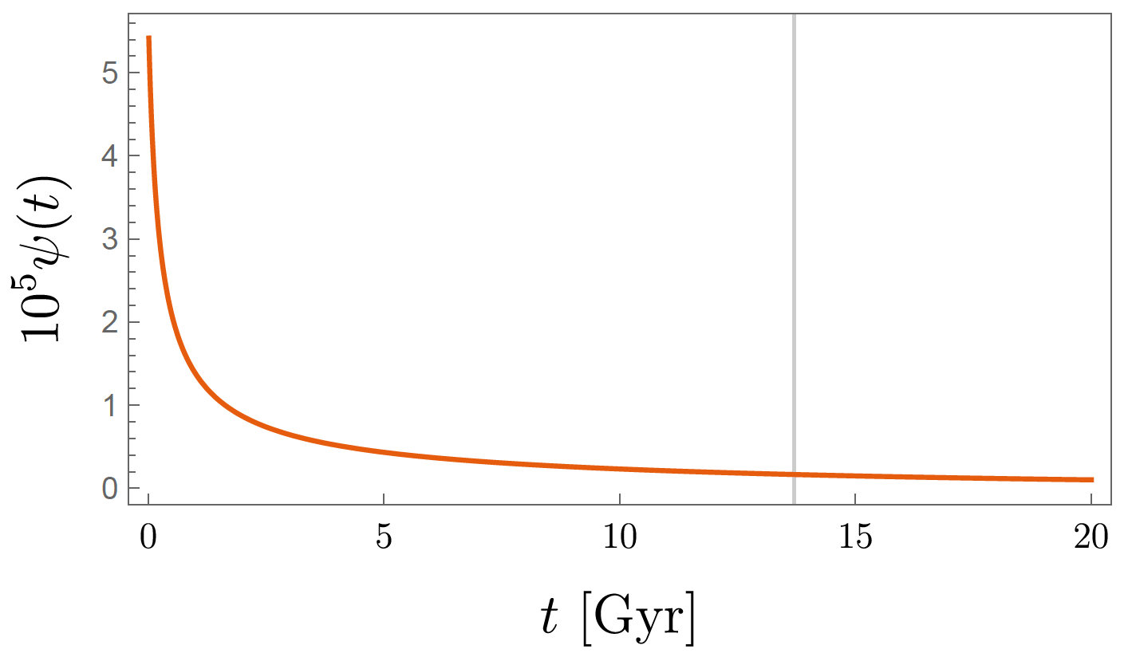
Results

Slide 24
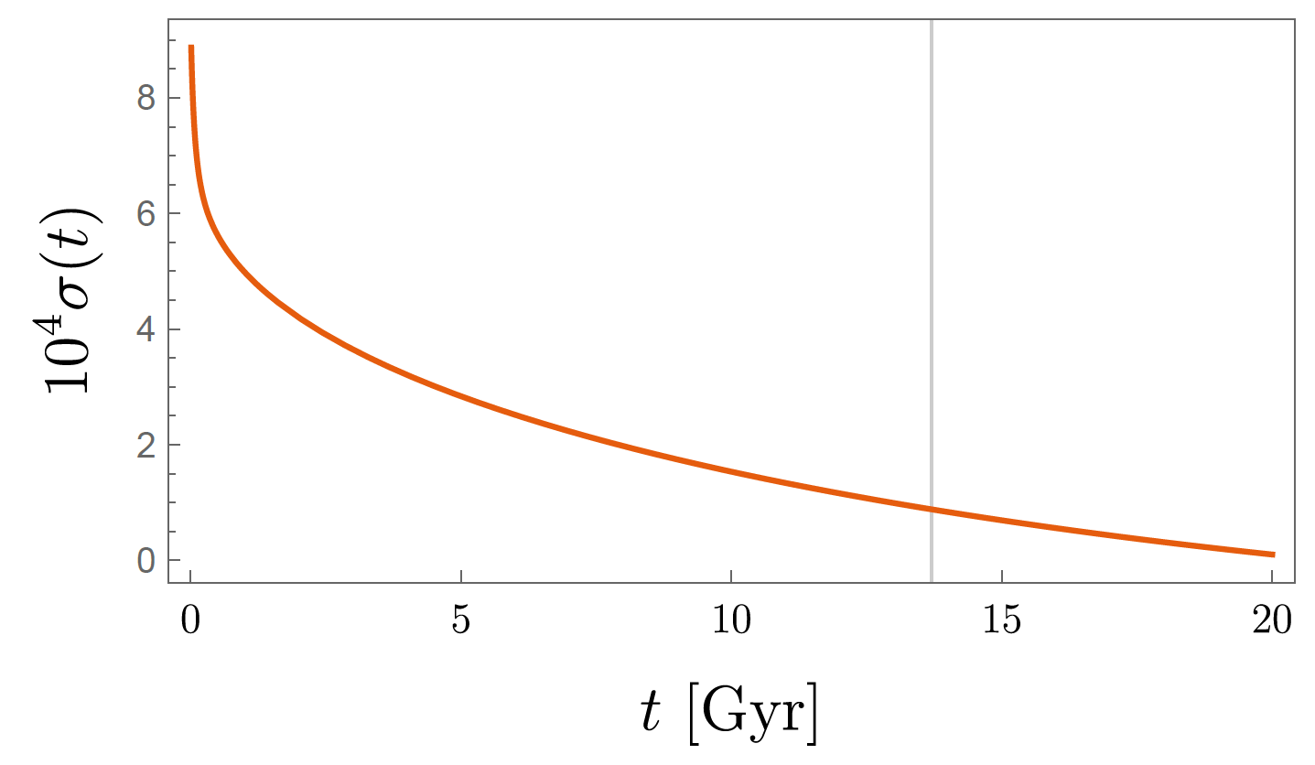
Results

Slide 25
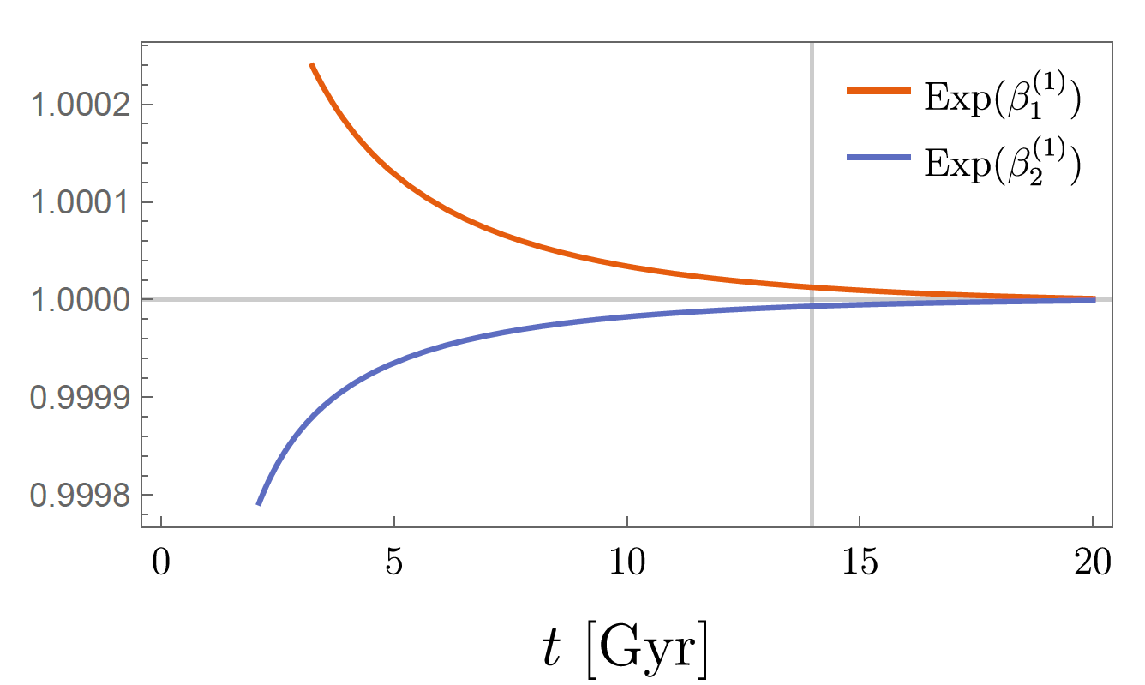
Results
Notes:
Those are first order of scale factor. We can check the anisotropies decay at the future. So universe recovers the isotropy.

Slide 26
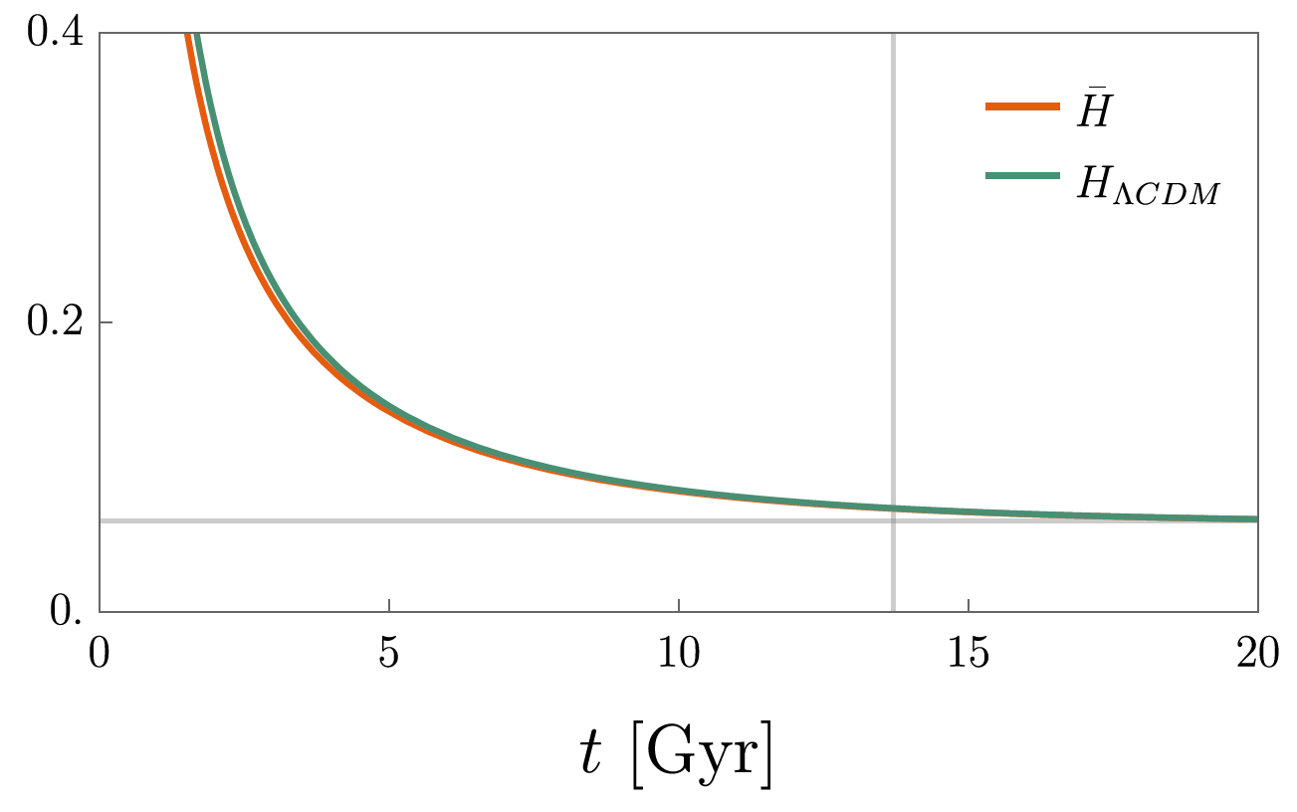
Results
$$\overline{H}=\frac{1}{3}\left(3\dot{α}+ε{\dot{β}}_{1}^{(1)}+2ε{\dot{β}}_{2}^{(1)}\right)$$
Average Hubble Parameter:
Notes:
This is a average Hubble parameter. Actually, the Hubble
parameter is smaller than LCDM. It means that the hubble
tension is worse.

Slide 27
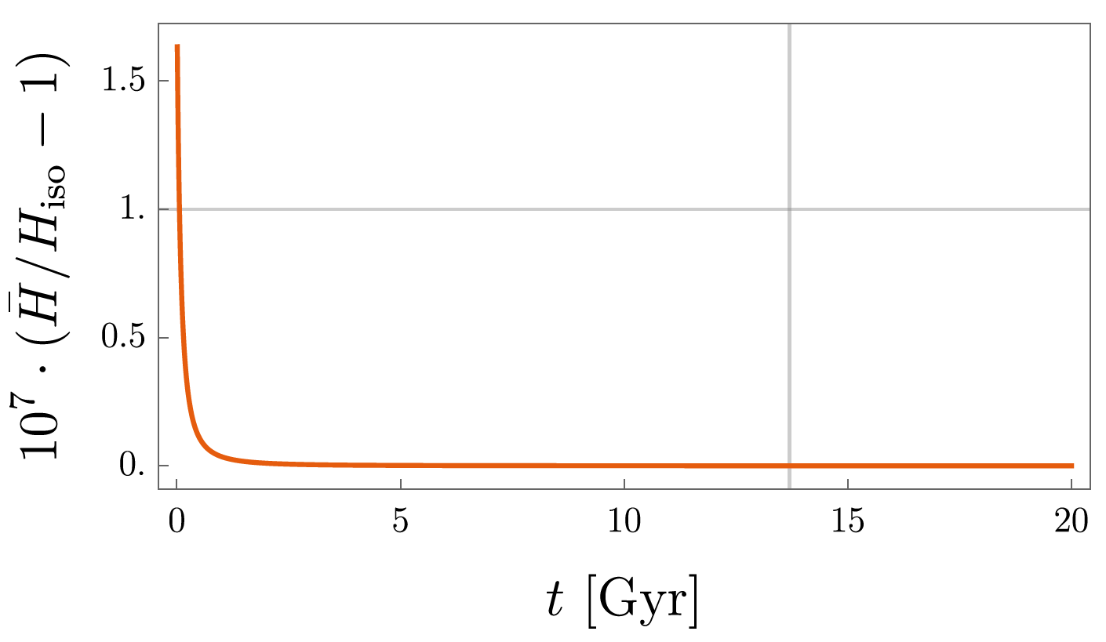
Results
Notes:
This is a ratio of Hubble parameters. In the view of Hubble
parameter, the isotropy recovered in early time.

Slide 28
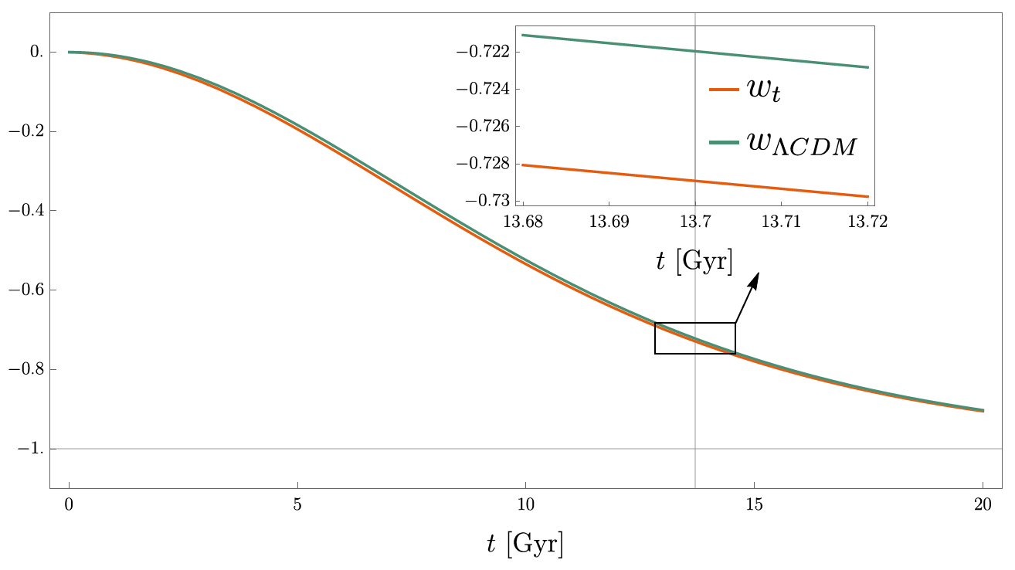
Results
$$P_{Tot}=ω_{t}ρ_{Tot}$$
Notes:
This is a ratio of pressure and density, which comes from
the equation of state. The LCDM case is little bit bigger than
our case.

Slide 29
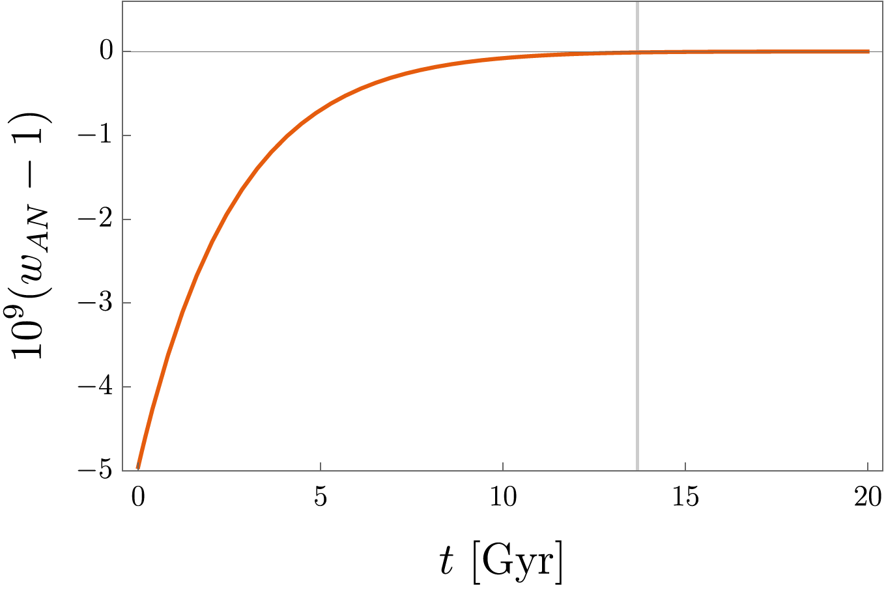
Results
$$ω_{AN} \sim 1$$
Stiff Matter
Notes:
One thing to note, if we only consider the anisotropic part,
the ratio is almost 1 and it has been studied in the context of
both classical and quantum cosmology as stiff matter.

Slide 30
Summary
Obviously, there seem to be anisotropies in the universe. Therefore, we need a mechanism to generate cosmological anisotropies.
We investigated the cosmological anisotropies in Bianchi type VII₀ spacetime at the first-order perturbation level.
The cosmological anisotropies arise at early time and decay at future infinity.

Slide 31
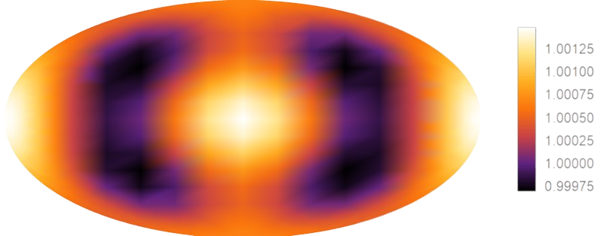
Furthermore . . .
$$S=\int{d^{4}x \left(…+V\left(φ\right)−\frac{1}{4}F_{μν}^{a}F_{a}^{μν}−\frac{Θφ}{4}F_{μν}^{a}{\tilde{F}}_{a}^{μν}+…\right)}$$
$${\left(\frac{ΔT_{ℓ}}{T_{0}}\right)}^{2}=\frac{1}{2π}\frac{ℓ\left(ℓ+1\right)}{2ℓ+1}\sum_{m}{\left|a_{ℓm}\right|}=𝓠^{2}={\left(iso.\right)}^{2}+{\left(ani.\right)}^{2}+2\left(cro.\right)$$
Model
CMB

Slide 32
Thank You!

