Slide 1
Constructing the covariant vertices systematically
Seong Youl Choi (Jeonbuk National University)
SYC, Jae Hoon Jeong
PRD 103 (2021) 096013
PRD 104 (2021) 055046
PRD 105 (2022) 016016
?
CQUeST 2023, Jeonju, August 3, 2023

Slide 2
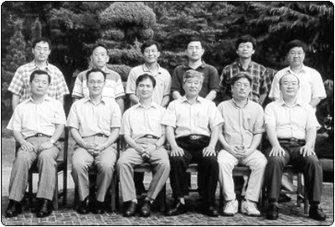
In memory of Prof. Chaiho Rim
(1984-2009 @ JBNU)
2002

Slide 3
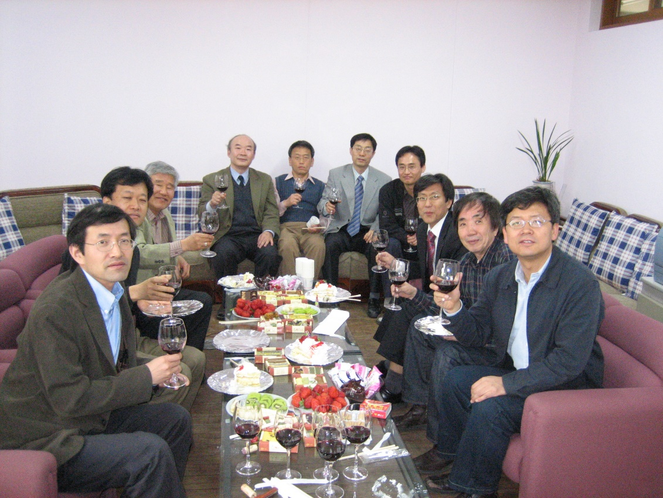
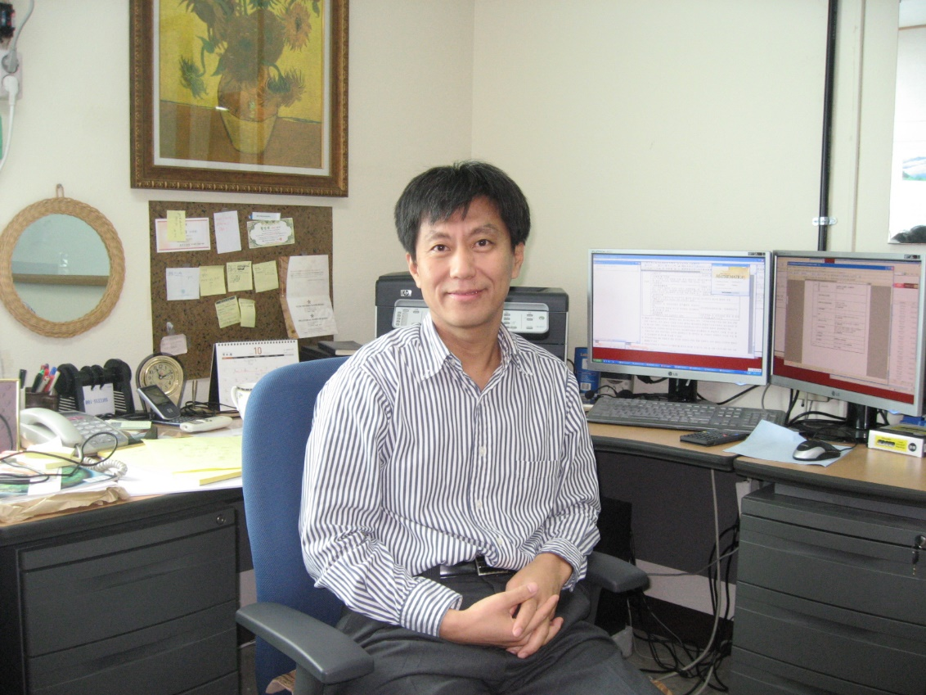
BK21 in 2006
Office in 2007

Slide 4


Mt. Naejang in 2004

Slide 5

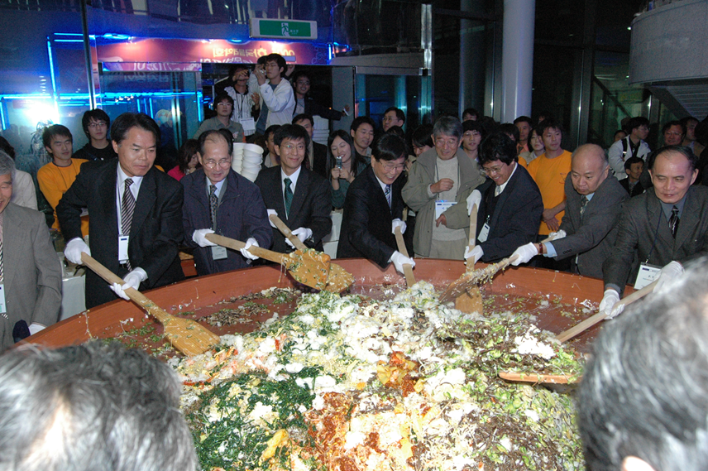
2005 KPS fall meeting @ JBNU
3rd edition in 2021

Slide 6
Introduction
The Standard Model is established but yet incomplete!
How to go beyond the Standard Model?
Top-down conventional (?) path
A Lagrangian ⇒ propagators and vertices
Bottom-up effective field theory (EFT) path
All the Lorentz-covariant local vertices, …
In this talk
I will describe a systematic algorithm for constructing all
the covariant 3-point vertices and mention a few applications.
For an authoritative SM history,
Steven Weinberg,
PRL 121 (2018) 220001
Steven Weinberg, EPJH (2021) 46:6
All Things EFT @ YouTube

Slide 7
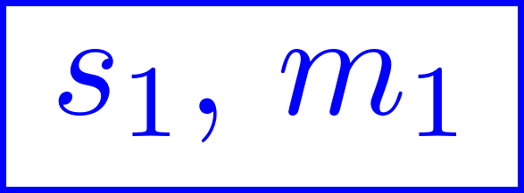
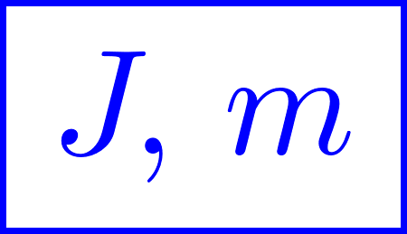
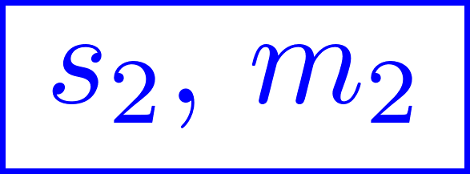



Key Connection
Covariant
$X$ rest frame ($X$RF)
Decay helicity amplitude
Jacob, Wick
AP7 (1959) 404
$X$RF
valid in any frame
(covariant) wave tensors

Slide 8


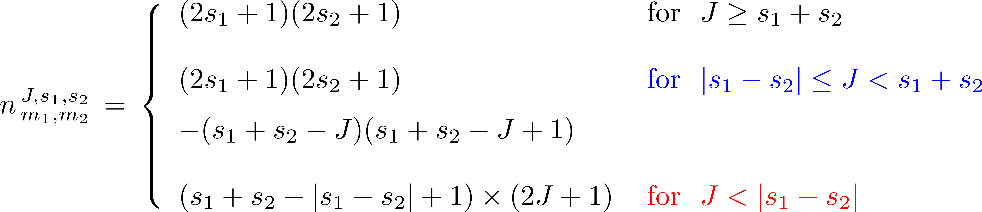



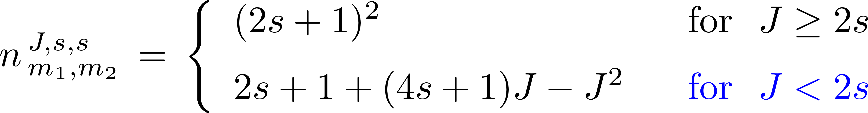
Number of independent terms
Massive
SU Chung
PRD 57 (1998) 431

Slide 9

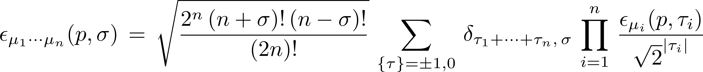
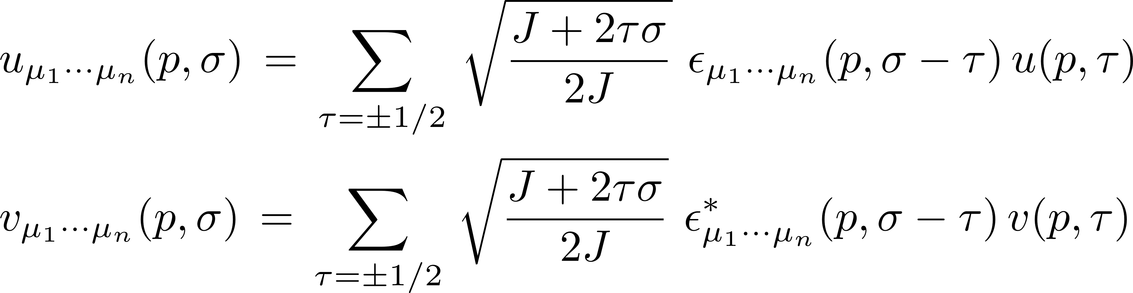
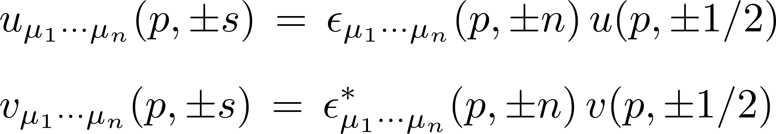
Wave tensors
Behrends, Fronsdal, PR 106 (1957) 345
Scadron, PR 165 (1958) 1640
massive
massless
massive
massless

Slide 10
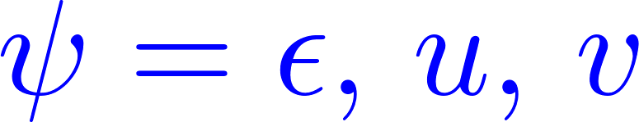
General properties of the wave tensors
Behrends, Fronsdal,
PR 106 (1957) 345
Scadron,
PR 165 (1958) 1640
totally symmetric
traceless
divergence-free
fermionic divergence-free

Slide 11
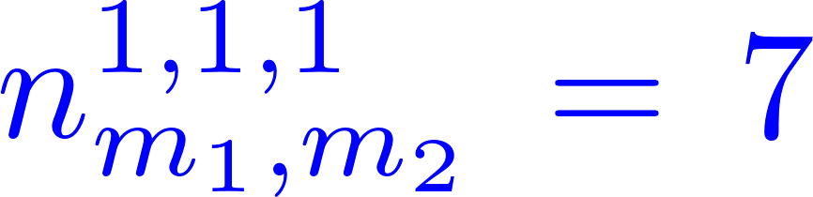
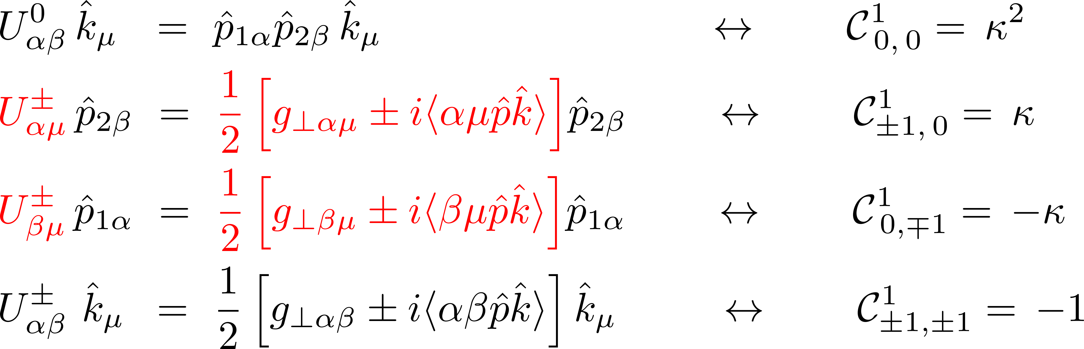
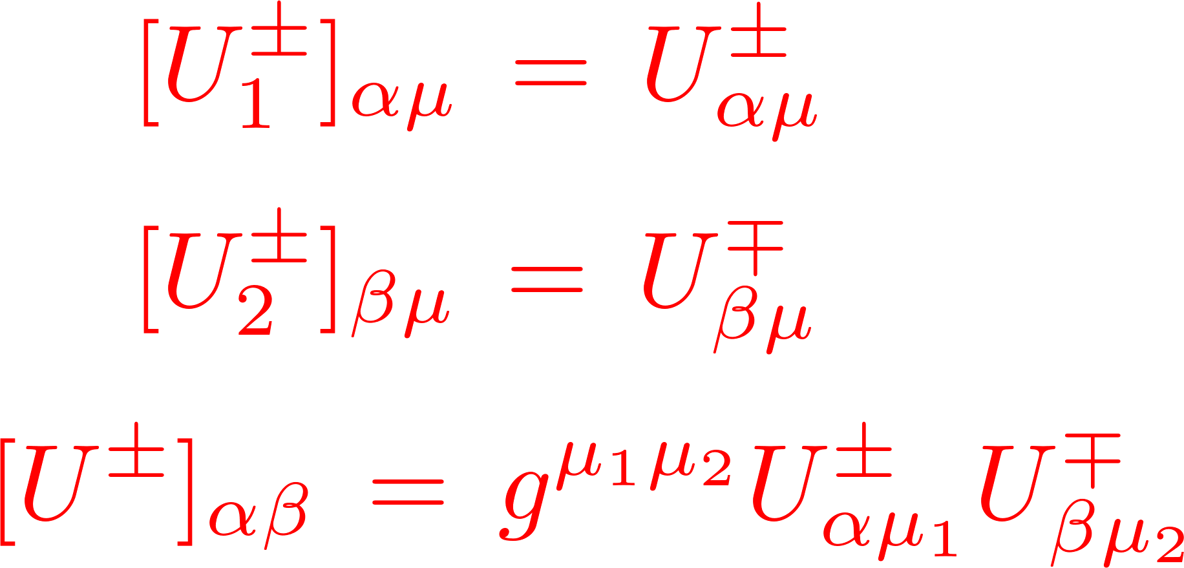
Bosonic transition operators
SYC, JH Jeong
PRD 105 (2022) 016016
Each exclusive
helicity
combination

Slide 12
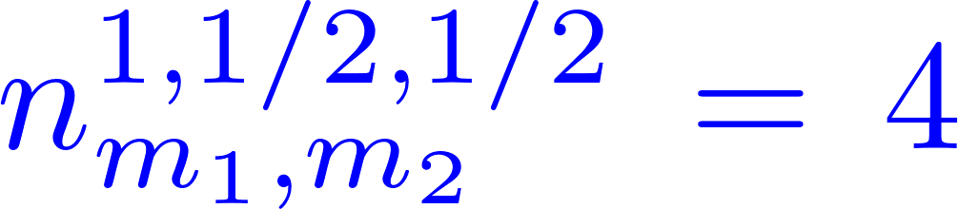
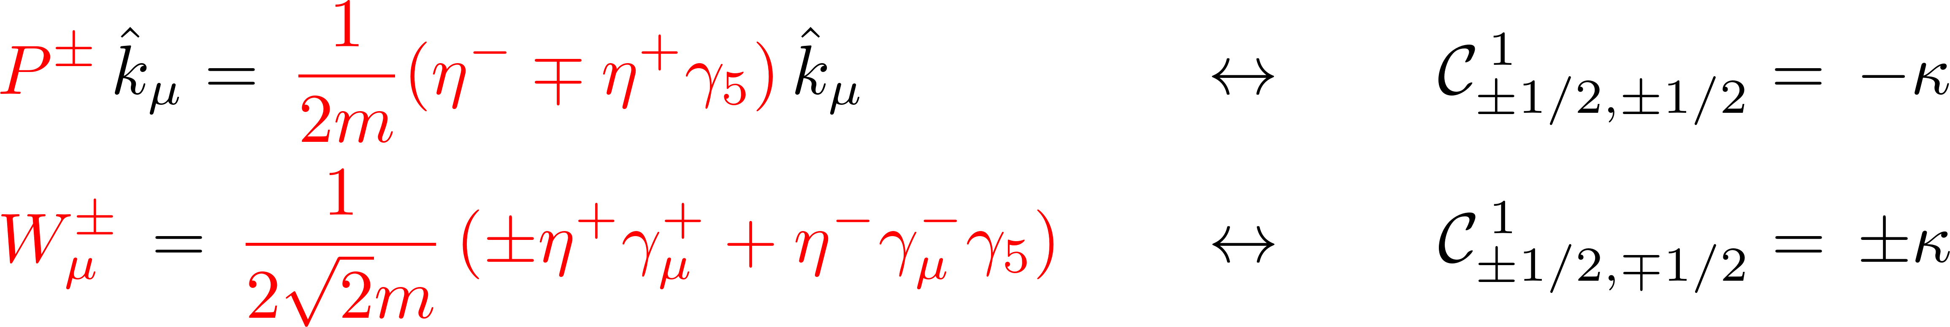
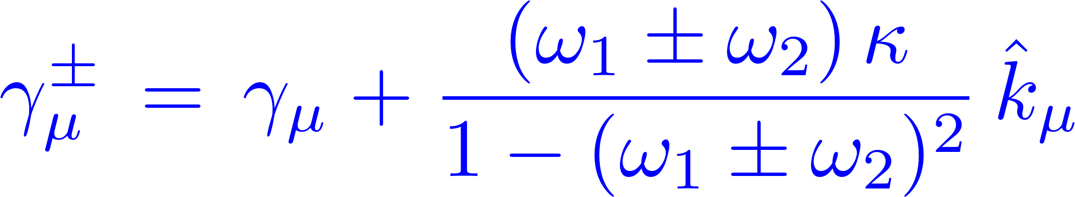
Fermionic transition operators
SYC, JH Jeong
PRD 105 (2022) 016016
Each exclusive
helicity
combination

Slide 13
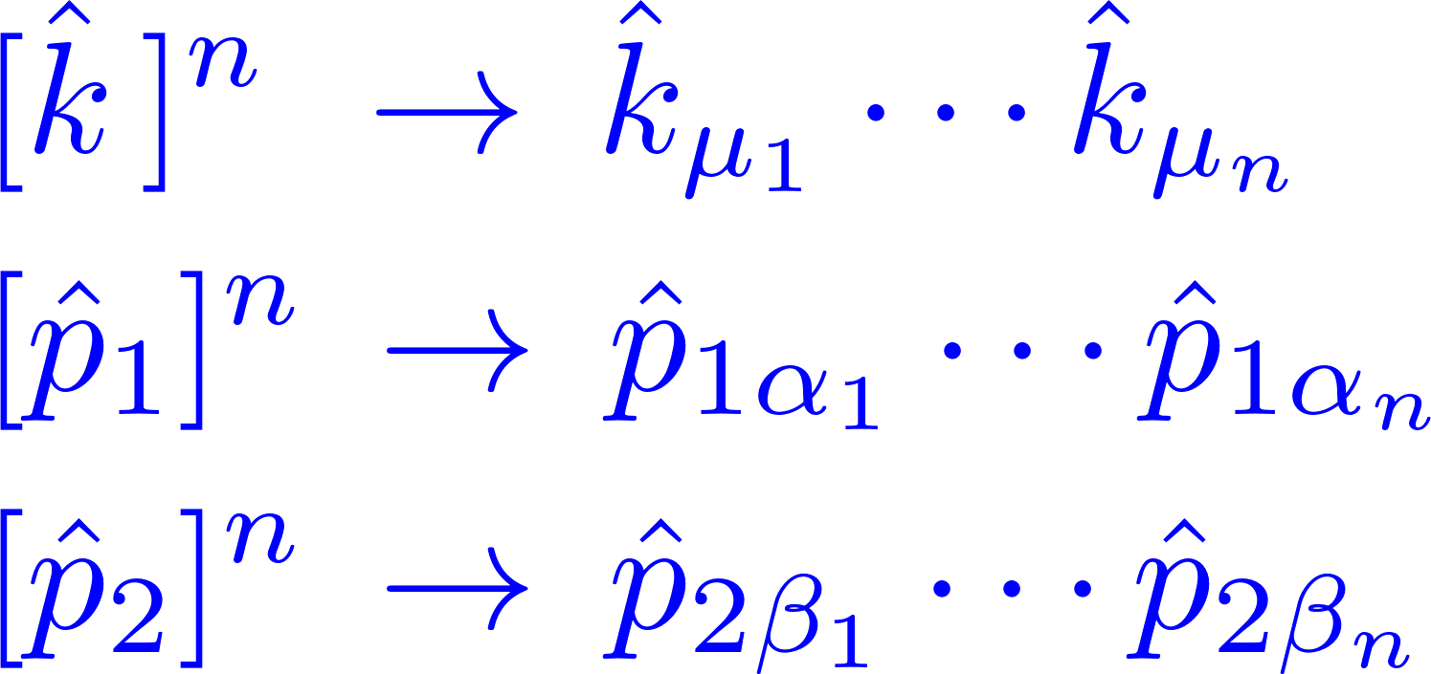
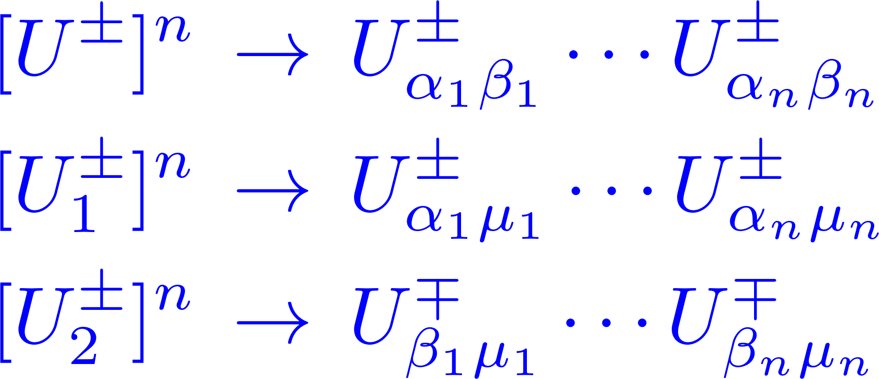
Compact square-bracket notations

Slide 14
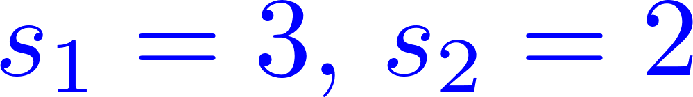
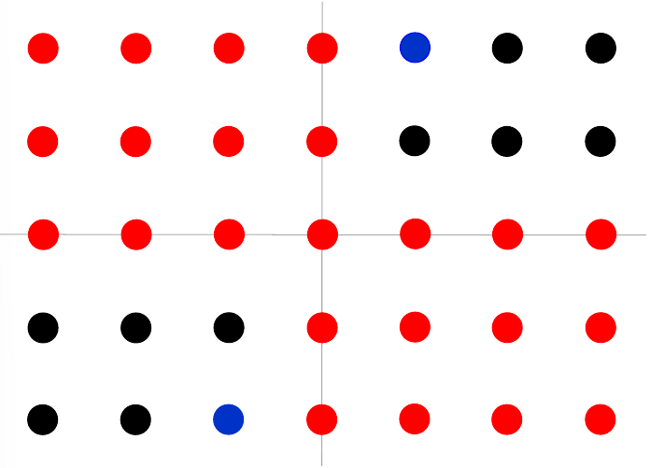
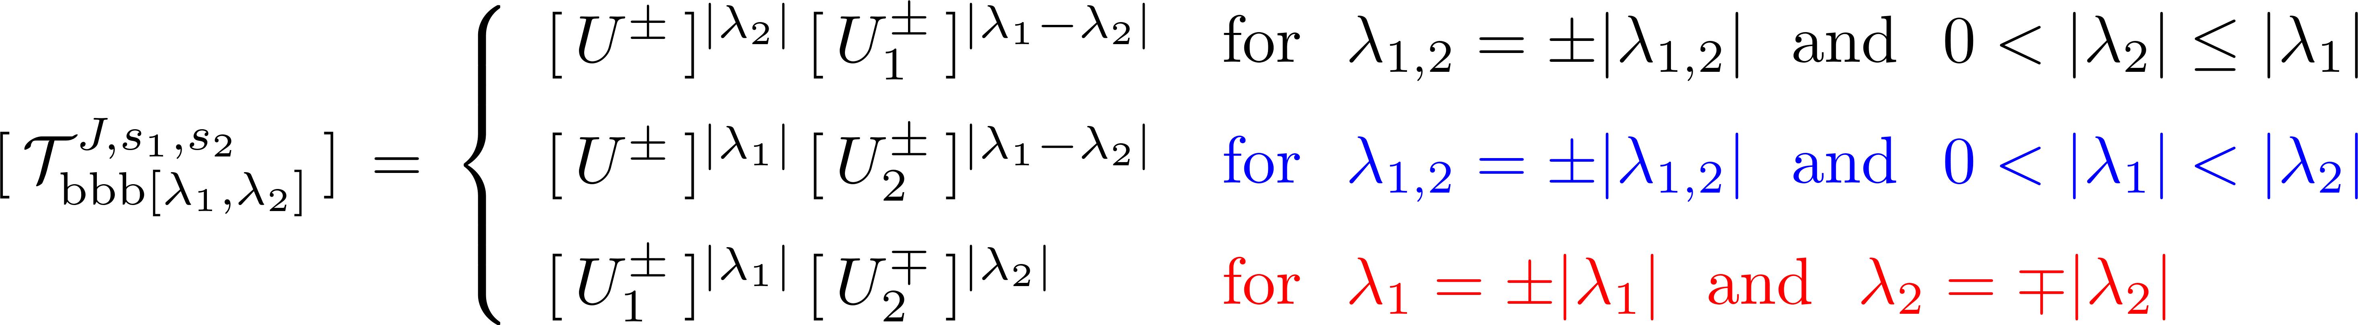
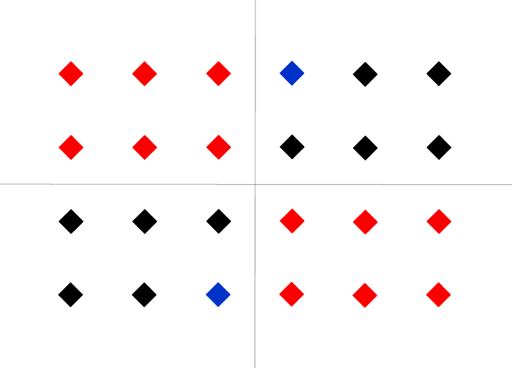
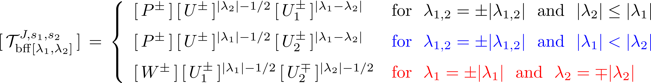
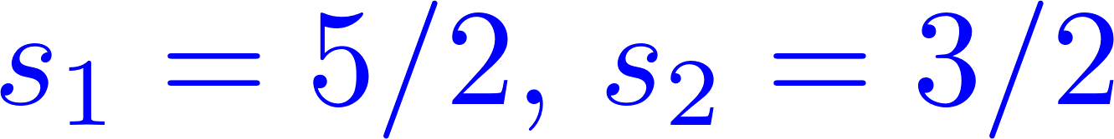
Covariant 3-point helicity-specific vertices
SYC, JH Jeong
PRD 105 (2022) 016016

Slide 15
SYC, JH Jeong
PRD 105 (2022) 016016
A general covariant 3-point vertex
A linear combination of all the helicity-specific 3-point vertices

Slide 16
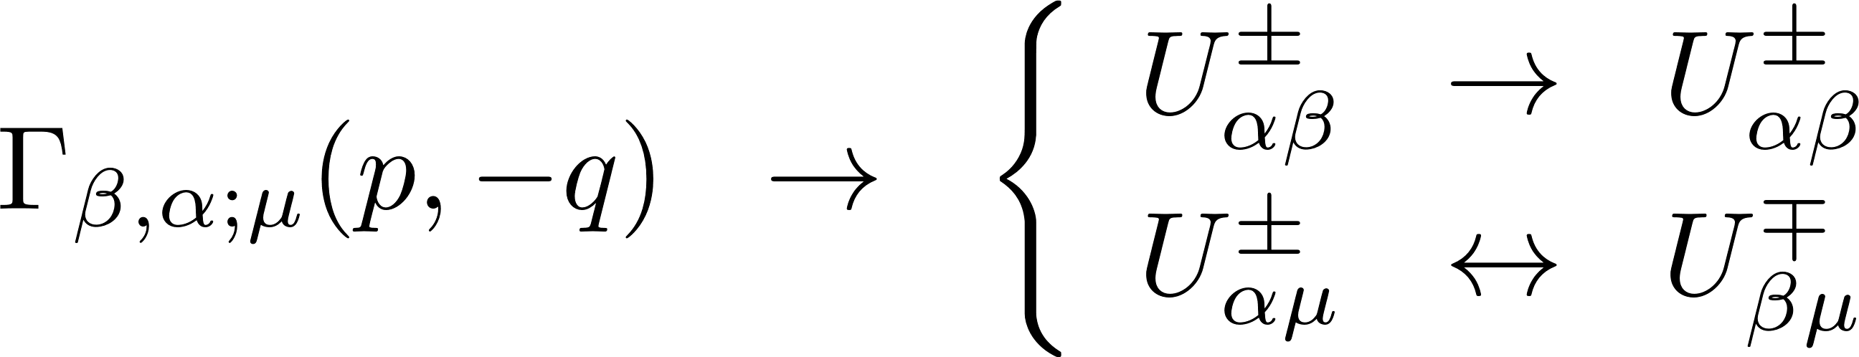
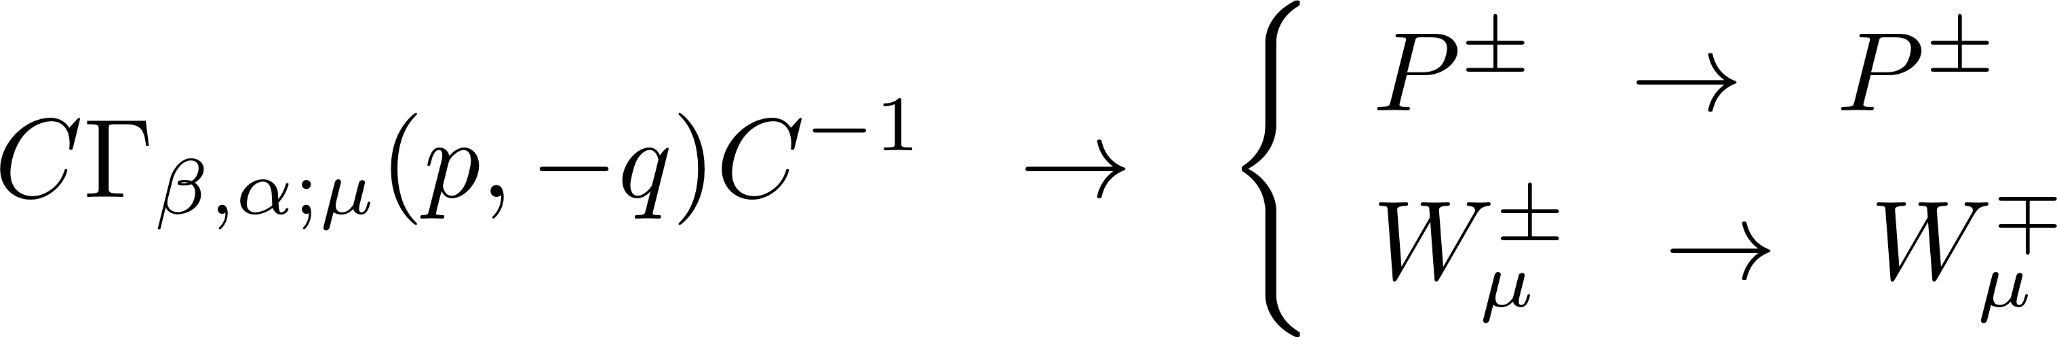
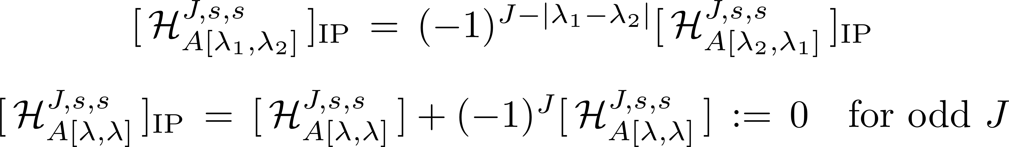
3-point covariant vertices of two identical particles
Kayser, PRD 26 (1982) 1662
SYC, JH Jeong
PRD 104 (2021) 055046

Slide 17
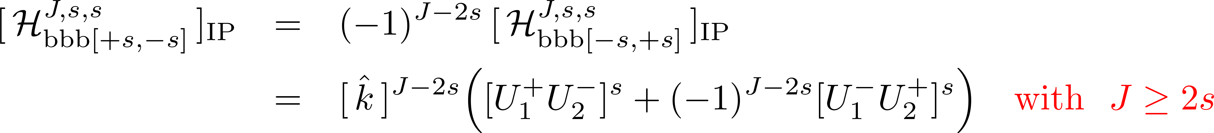

3-point vertices of two identical massless particles
(generalized LY theorem)
SYC, JH Jeong
PRD 104 (2021) 055046

Slide 18
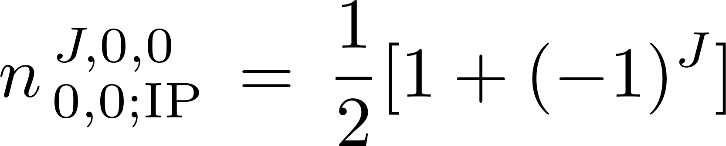
Number of independent terms (IP)
SYC, JH Jeong
PRD 104 (2021) 055046
Massive
Generalized Landau-Yang (LY) theorem
Landau, DANS 60 (1948) 207
Yang, PR 77 (1950) 242
SYC, JH Jeong
PRD 103 (2021) 096013

Slide 19

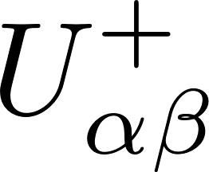
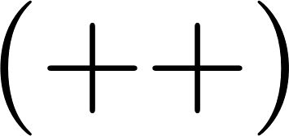
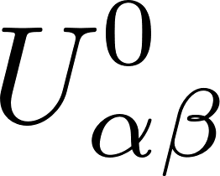
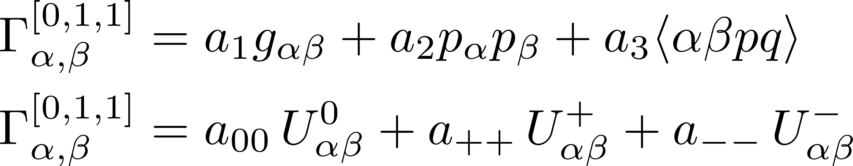
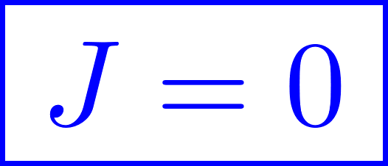
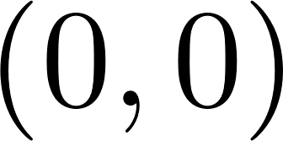
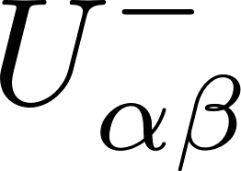
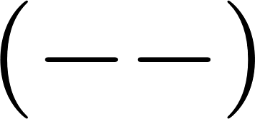
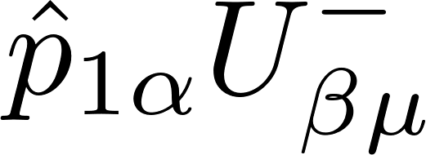
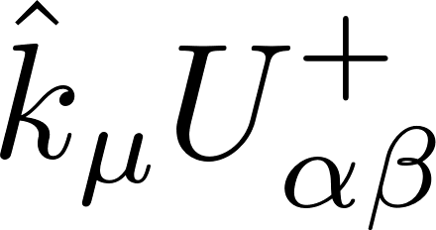
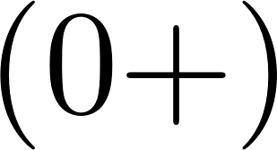
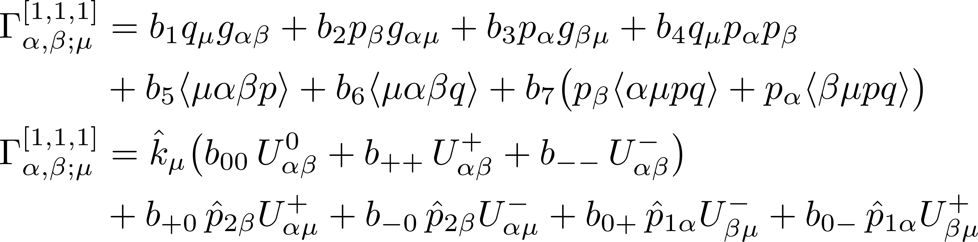
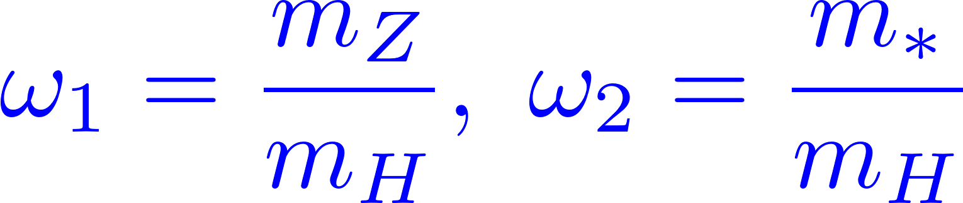
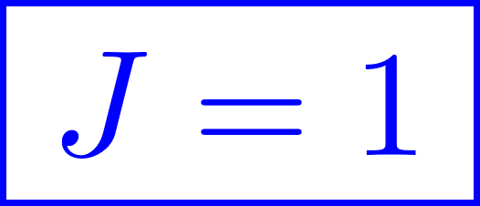
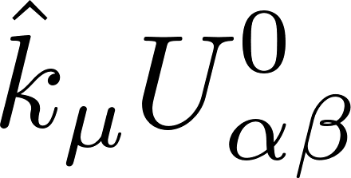
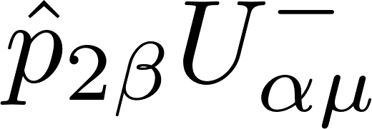
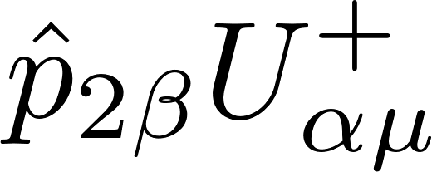
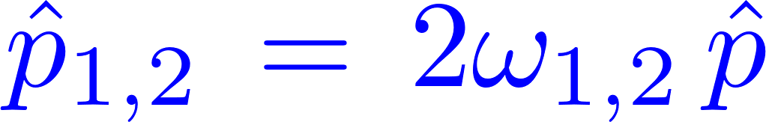



















SYC, Miller, Muhlleitner, Zerwas, PLB 553 (2003) 61
SYC, in progress
on-shell

Slide 20







Boudjema, Hamzaoui, PRD 43 (1991) 3748
SYC, JH Jeong, IG Jeong, SD Shin, in progress
-s-1 … 0 1 … s
-s-1 … $−\frac{1}{2}$ $\frac{1}{2}$ … s

Slide 21

Comments
Gauge and discrete symmetries
Spinor helicity formalism
(Dirac, PRSLA 155 (1936) 447, … ,
Arkani-Hamed, TC Huang, Yt Huang,
JHEP 11 (2021) 070)
Hypercharge anapole DM
(SYC, JH Jeong, IG Jeong, SD Shin, in progress)
High-spin DM particles
(Babichev ea, PRD 94 (2016) 084055, …, Gondolo,
S Kang, Scopel, Tomar, PRD 104 (2021) 063017)
High-spin targets for DM detection
(SYC, Drees, JH Jeong, in progress)
Off-shell vertices and propagators
4-point covariant vertices, …
Application to various processes
(SYC ea in progress)
Program for automatic evaluation
(JH Jeong ea, in progress)
⋮
Workman ea, PTEP (2022) 038C01 [PDG]

Slide 22
Summary
Exploiting the equivalence between the helicity formalism and
the covariant formulation, we identified all the basic operators
for constructing any Lorentz covariant three-point vertices.
We presented all the helicity-specific covariant three-point vertices
to be combined into a general covariant three-point vertex.
We worked out the case with two identical particles fully.
We expect the general algorithm to enable us to work out
various theoretical and phenomenological aspects effectively.
An interesting work is how to synthesize the bosonic and
fermionic cases in a compact and unified way.
⋮

Slide 23
Back-up Slides

Slide 24





Hagiwara, Peccei, Zeppenfeld, Hikasa, NPB 282 (1987) 253

Slide 25


