Slide 1
Memories of Prof. Chaiho Rim at CBNU
One of the happiest time in concentrating on physics and starting Horava gravity.
Sorry that we had no chance to study Horava gravity together though we might have it.
Thanks to Prof. Rim for a geneorus support and encouragement at CBNU.
Last scientific encouragement at 거구장(k-turtle) after retirement celebration party: “ Push more on De Sitter and Expect important contributions,…”

Slide 2
On No Scalar-Haired Cauchy Horizon Theorem in Higher-Curvature Gravities: An Introduction.
CQUeST 2023 (Aug. 01, 2023)
Mu-In Park (CQUeST/Sogang U.)
Collaboration with Deniz O. Devecioglu (CQUeST)
Phys.Lett.B 829 (2022) 137107; arXiv: 2307.10532 [hep-th]

Slide 3
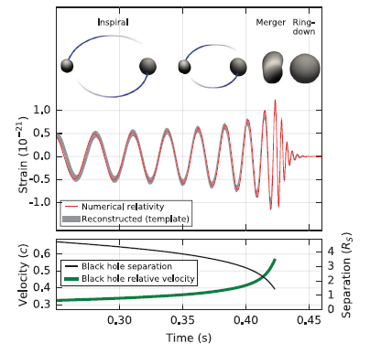
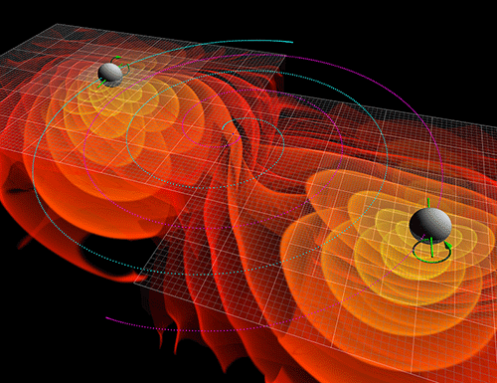
Black Holes Do Exist in Nature !
LIGO ‘15

Slide 4
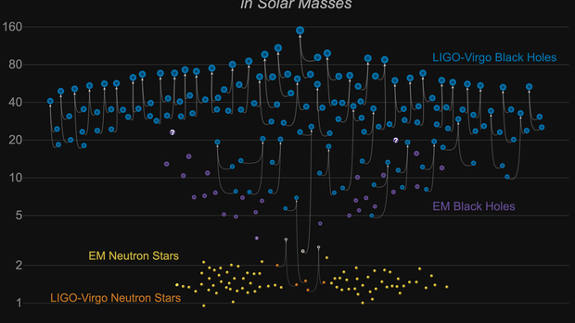
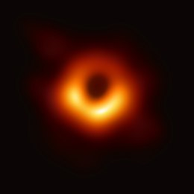
LIGO/VIRGO ‘20
EHT ‘17

Slide 5
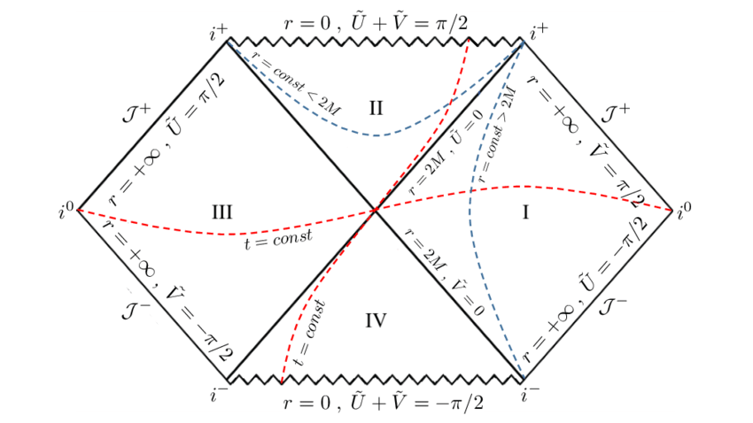
Black Hole Interior is not well understood yet!
1. There is a (space-like) singularity (Penrose): Is this the end of physics ?

Slide 6
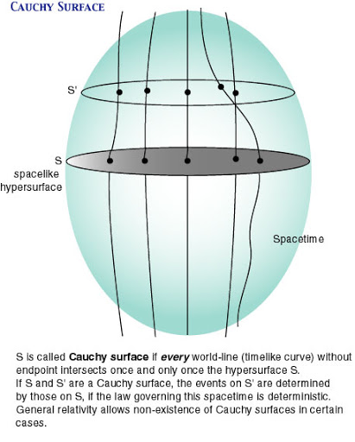
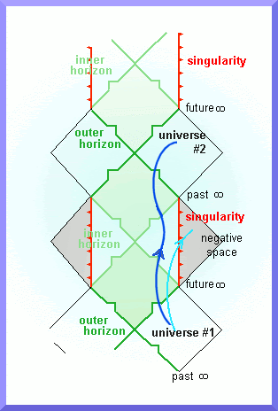
2. There is a Cauchy horizon (RN, Kerr) and time-like singularity

Slide 7
Doubts on Cauchy Horizon (CH)
1. Lack of predictability in GR beyond CH ?
2. Singularity can be “seen” by a time-like observer ?
3. CTC (closed time-like curve/Time Travel) for Kerr, rotating BTZ,…
Resolutions ?
1. Unstable CH
2. CH never forms, instead singularities form.

Slide 8
No Inner (Cauchy) Horizon Theorem
2. Hartnoll, Horowitz, Krutho and Santos, arXiv:2008.12786 (Charged Black Hole(k=0), Charged Scalar Field)
3. Cai, Li, Yang, arXiv:2009.05520 (Charged Black Hole(k=0,1,-1), Charged Scalar Field)
“There exists No Inner Cauchy Horizon for k=0,1 and non-trivial (non-zero, finite) scalar hair. But it can exist for k=-1.” [R+F^2+scalar]

Slide 10
I was surprised at
1. Simplicity of the proof.
2. Quite generic results: No dependence on the scalar potential Quite Far-reaching applicability !!
(cf. Usual no hair proof)

Slide 11
So, I wanted to “classify all possible extensions” of the theorem.
Originally, I thought that Higher-Curvature gravities “should” respect the theorem in some ways. For example, “L=R+R^2+…” can be considered as L’=R+scalar+…”
Motivated by this, we considered a Horndeski gravity with Einstein coupling to scalar and found that the theorem can be extended in that case, with a proper sign of the coupling constant
[Devecioglu-Park arXiv:2101.10116 [PLB (2022)]]

Slide 12
Our result was the first higher-curvature gravity extension but with no higher-derivative initial data (second-order EQM)!
As another higher-curvature gravity extension, we also considered Gauss-Bonnet gravity [R+scalar+f(scalar)GB], whose EQM remain second-order!
[Devecioglu-Park arXiv: 2307.10532 [hep-th]]. (Details: Deniz’s talk)

Slide 13
Plan
I. Review of “Cai, Li, Yang, arXiv:2009.05520”
II. Extensions to Higher-Curvature Gravities.

Slide 14
I. Review of “Cai, Li, Yang, arXiv:2009.05520”
Consider Einstein-Maxwell-Scalar theory,

Slide 15
EOM
Take an ansatz (static, isotropic),
Phase field=0

Slide 17
Reduced EOM ((4)-(7))

Slide 18
Proof of No Inner-Horizon Theorem:
Suppose two horizons,
For a regular horizon (no singularity at the horizon), metric and matter fields should be smooth near the horizons.

Slide 19
For a charged scalar field (non-zero q):
From the regularity at the horizons ( ) , we have two possibilities:
(a): Non-trivial scalar field and finite
(b): Trivial scalar field

Slide 20
Another key observation:
(Radially) Conserved charge:
Using EOM, one can find
k=0: scale symmetry
K=1,-1: Broken scale symmetry

Slide 21
Consider Q at the horizons
Then, from we obtain
From , we find

Slide 22
:
LHS<0
RHS: Integrand is positive
(i) RHS>0 for k=0,1 (No smooth Inner horizon)
(ii) RHS<0 for k=-1 (Inner horizon is possible!)

Slide 23
No Scalar-haird Inner Horizon Theorem
Power of Theorem: Far-reaching applicability due to no dependence on V. (cf. Usual no hair theorem)
For k=-1, scalar-haird inner horizon is also possible. But, no exact (analytic) solutions are known and we need find numerical solutions to test the theorem explicitly.
This is for charged scalar field. For neutral scalar field, we need an independent but the usual proof depending on potential. (see the paper).

Slide 24
Numerical solution for haired-Inner horizon
k=-1, d=2 (3+1 dimensions), AdS

Slide 25
(i). Mass is tachyonic but above BF bound.
(ii) No new singularity other than at the origin (z= )

Slide 26
II. Extensions to Higher-Curvature Gravities
1. Einstein-Maxwell-Horndeski Theories [DD&MIP, arXiv:2101.10116 [PLB (2022)]]

Slide 27
For a static ansatz (in the Schw. Coord)
Phase field=0

Slide 28
EOM (D=4): 2nd order Eq.

Slide 29
Arbitrary D>4: no new D-dependent effect.

Slide 30
From the regularity at the horizons, we have the same condition, for a non-trivial charged scalar hair, as Einstein gravity case,
Radially conserved charge:

Slide 31
On-shell conservation: (cf. Cai. et. al)
From

Slide 32
Theorem still works for !

Slide 33
2. Einstein-Maxwell-Gauss-Bonnet-Scalar [DD&MIP, arXiv:2307.10532 [hep-th]]
Static ansatz:
Phase field=0

Slide 34
EOM (D=4): 2nd order Eq.

Slide 35
Arbitrary D: There are D(>4)-dependent terms!

Slide 36
From the regularity at the horizons, we have the same condition for a non-trivial charged scalar hair, as Einstein gravity case,
Radially conserved charge:

Slide 37
On-shell conservation:
From

Slide 38
k=0: Theorem still works.
k=1,-1: No simple condition for the theorem.
But, we still have a general criterion for the existence haired-inner horizon, RHS>0 since LHS>0.
To test the theorem, we need to find numerical solutions due to lack of exact solutions, as in Einstein gravity case.

Slide 39
Numerical solutions for scalar-haired Inner horizon (More details: Deniz’s talk)
Recover Einstein gravity case

Slide 40
No deep-interior (r<r_) solutions are found due to increasing errors at r_.

Slide 41
Radially conserved scaling charge:
The general criterion works.

Slide 42
Our solutions are k=-1 cases and m^2<0 in AdS case, similar to Einstein case.
For k=1 case, there is no Einstein gravity limit (no haired-inner horizon solution) and so, only the non-Einstein branch may exist: We need to search rather unusual solution space to find it. (cf1. Miok Park’s talk)
For k=0, the theorem says “no-scalar haired solutions”.

Slide 43
Perturbative solutions?
At large r limit:
Two groups of power for scalar: For r^-a power, we have reasonable iterative solutions. But for r^-2a, some inconsistencies occur!!?? A consistent expansion is not clear yet!

Slide 44
Thank You !

