Slide 1
WIMP scenarios for DAMA/LIBRA-phase2
Sunghyun Kang
Sogang university

Slide 2
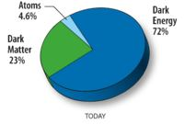
Introduction
Many evidences of Dark Matter
CDM(Cold Dark Matter)
Neutrino
WIMP
(Weakly Interacting Massive Particle)
"Content of the Universe - Pie Chart“
Wilkinson Microwave Anisotropy Probe. National Aeronautics and Space Administration. Retrieved 9 January 2018.

Slide 3
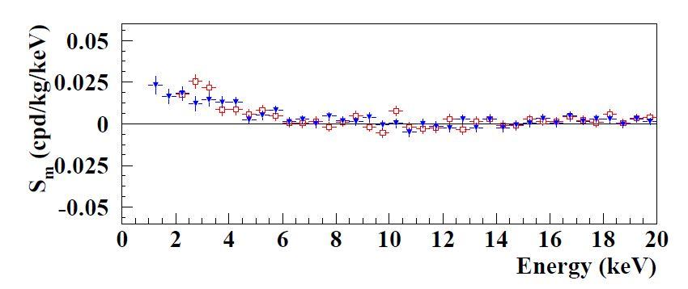
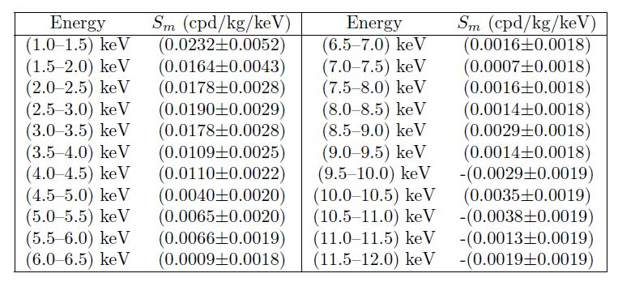
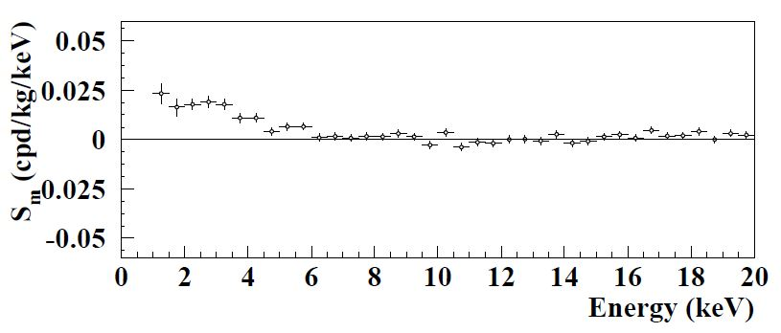
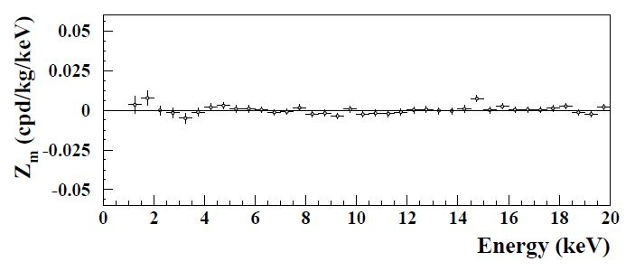
DAMA/LIBRA-phase2 analyses
Bernabei et al. (DAMA Collaboration), First model independent results from DAMA/LIBRA-phase2, 10.3390/universe4110116

Slide 4
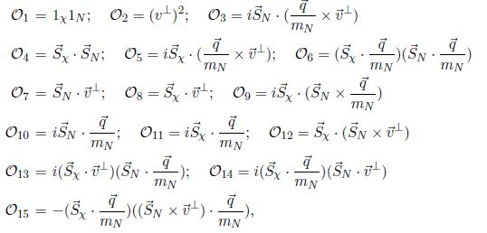
DAMA/LIBRA-phase2 analyses
τ : isospin
j : interaction type
W. Haxtonet al., The Effective Field Theory of Dark Matter Direct Detection, JCAP 1302 (2013) 004

Slide 5
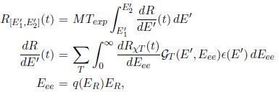
DAMA/LIBRA-phase2 analyses
${R_{l}}^{ττ^{′}}:$ WIMP response function
${W_{l}}^{ττ^{′}}$: nucleus response function: M, Σ’, Σ’’, Δ, φ’’, φ’ (M=SI, , Σ’, Σ’’=SD)
(from Nikhil Anand, A. Liam Fitzpatrick, W. C. Haxton,Model-independent WIMP Scattering Responses and Event Rates : A Mathematica Package for Experimental Analysis)
Sunghyun Kang, S.S., G. Tomar, J.H. Yoon DAMA/LIBRA-phase2 in WIMP effective models, JCAP07(2018)016

Slide 6
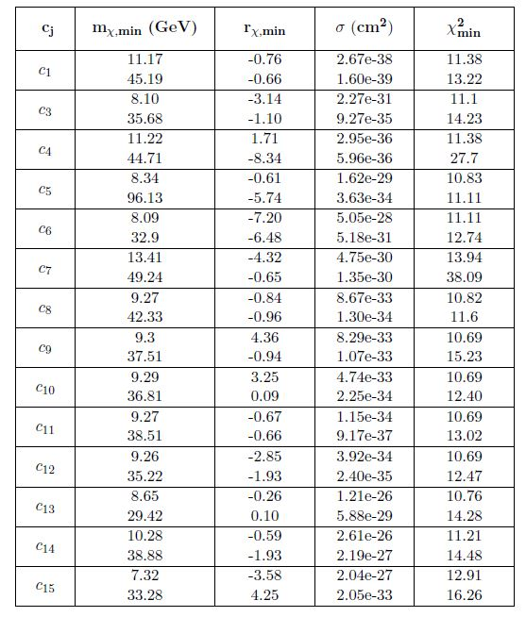
DAMA/LIBRA-phase2
Considering one EFT coupling at a time
Sunghyun Kang, S.S., G. Tomar, J.H. Yoon DAMA/LIBRA-phase2 in WIMP effective models, JCAP07(2018)016

Slide 7
DAMA/LIBRA-phase2 analyses
Sunghyun Kang, S.S., G. Tomar, J.H. Yoon DAMA/LIBRA-phase2 in WIMP effective models, JCAP07(2018)016

Slide 8
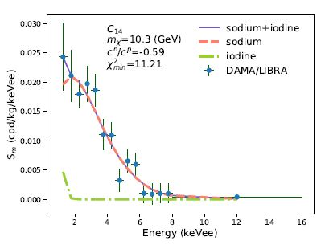
DAMA/LIBRA-phase2 analyses
Sunghyun Kang, S.S., G. Tomar, J.H. Yoon DAMA/LIBRA-phase2 in WIMP effective models, JCAP07(2018)016

Slide 9
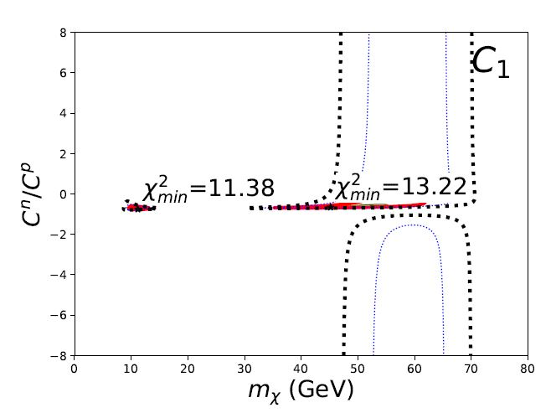
DAMA/LIBRA-phase2 analyses
Sunghyun Kang, S.S., G. Tomar, J.H. Yoon DAMA/LIBRA-phase2 in WIMP effective models, JCAP07(2018)016

Slide 10
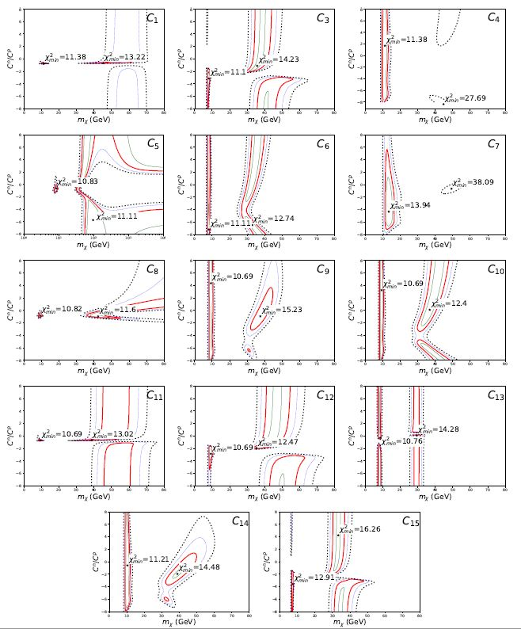
DAMA/LIBRA-phase2

Slide 11
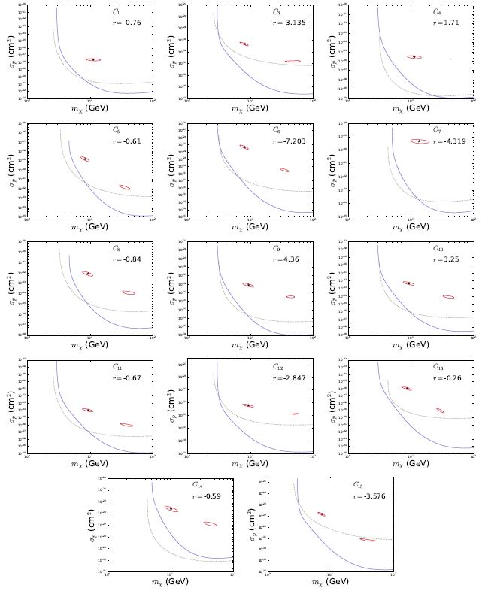
DAMA/LIBRA-phase2

Slide 12
pSIDM
How pSIDM evades constraints
Xe, Ge : spin-dependent WIMP-proton cross section(no interaction with neutron)
F : $v_{min}^{∗F}$ > $v_{esc}$
DAMA signal is okay since $v_{min}^{∗Na}$, $v_{min}^{∗I}$ < $v_{esc}$
Sunghyun Kang et al., Proton-philic spin-dependent inelastic Dark Matter (pSIDM) as a viable explanation of DAMA/LIBRA-phase2, 10.1103/PhysRevD.99.023017

Slide 13
pSIDM
Two states χ and χ’ with $m_{χ}<m_{χ′}$
All χ’ states have decayed to χ by now
Only upscatters of χ to χ’ are allowed
χ
χ
χ
χ'
nucleus
nucleus
nucleus
nucleus
D. Tucker-Smith and N.Weiner, Inelastic dark matter, Phys. Rev. D64, 043502

Slide 14
pSIDM
$m_{χ^{′}}−m_{χ}=δ$
Inelastic case : $δ≠0$
χ
χ'
nucleus
nucleus
Sunghyun Kang et al., Proton-philic spin-dependent inelastic Dark Matter (pSIDM) as a viable explanation of DAMA/LIBRA-phase2, 10.1103/PhysRevD.99.023017

Slide 15
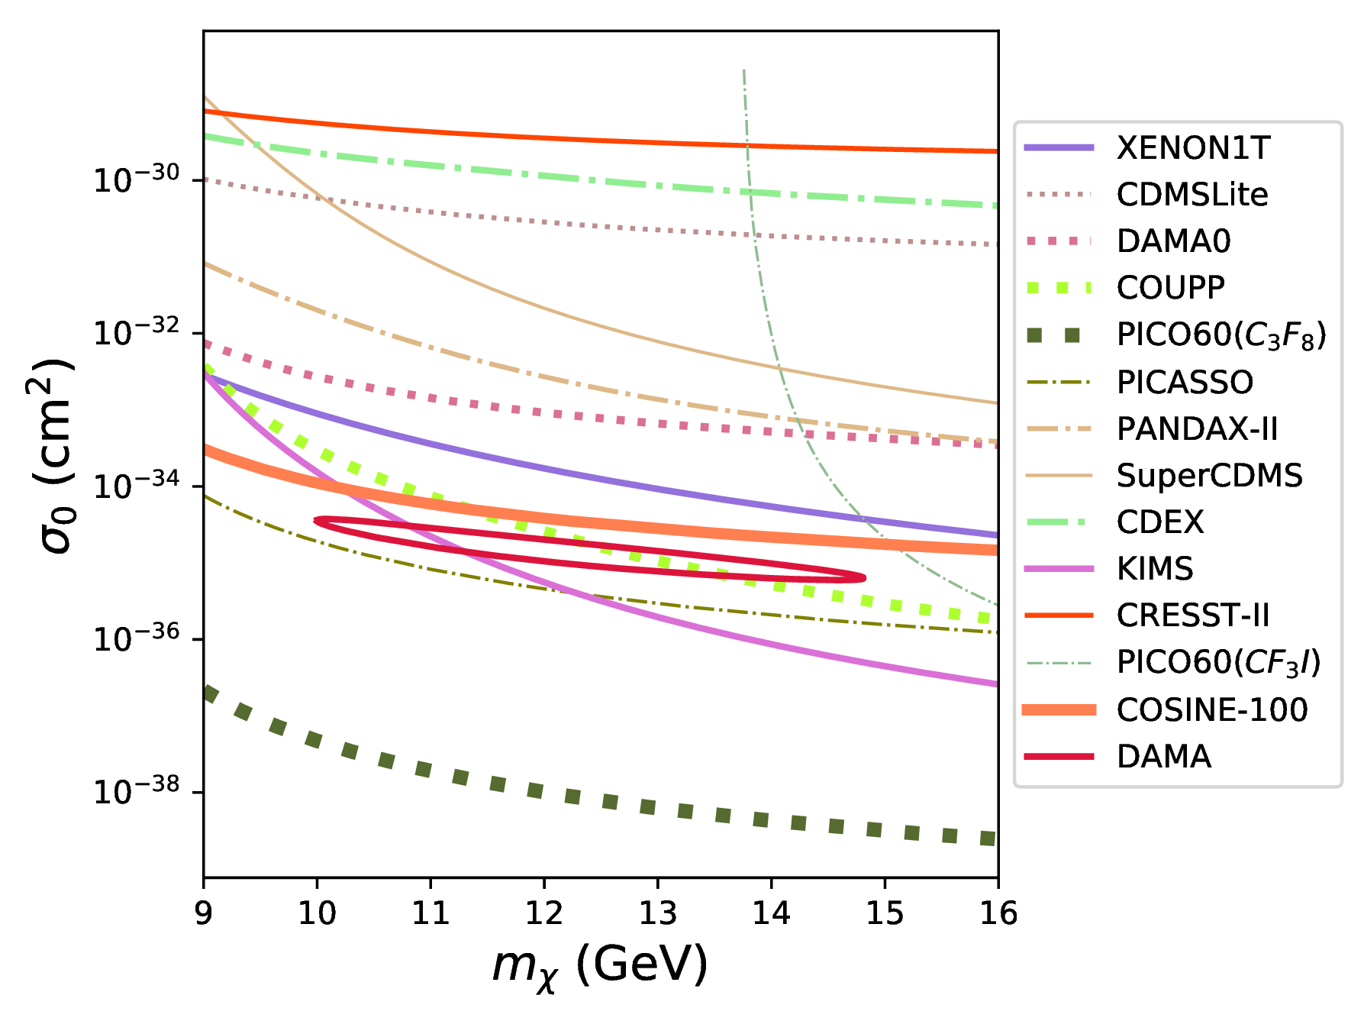
pSIDM
$v_{min}^{∗Na}$ < $v_{esc}$ < $v_{min}^{∗F}$
Maxwellian velocity distribution
Sunghyun Kang et al., Proton-philic spin-dependent inelastic Dark Matter (pSIDM) as a viable explanation of DAMA/LIBRA-phase2, 10.1103/PhysRevD.99.023017

Slide 16
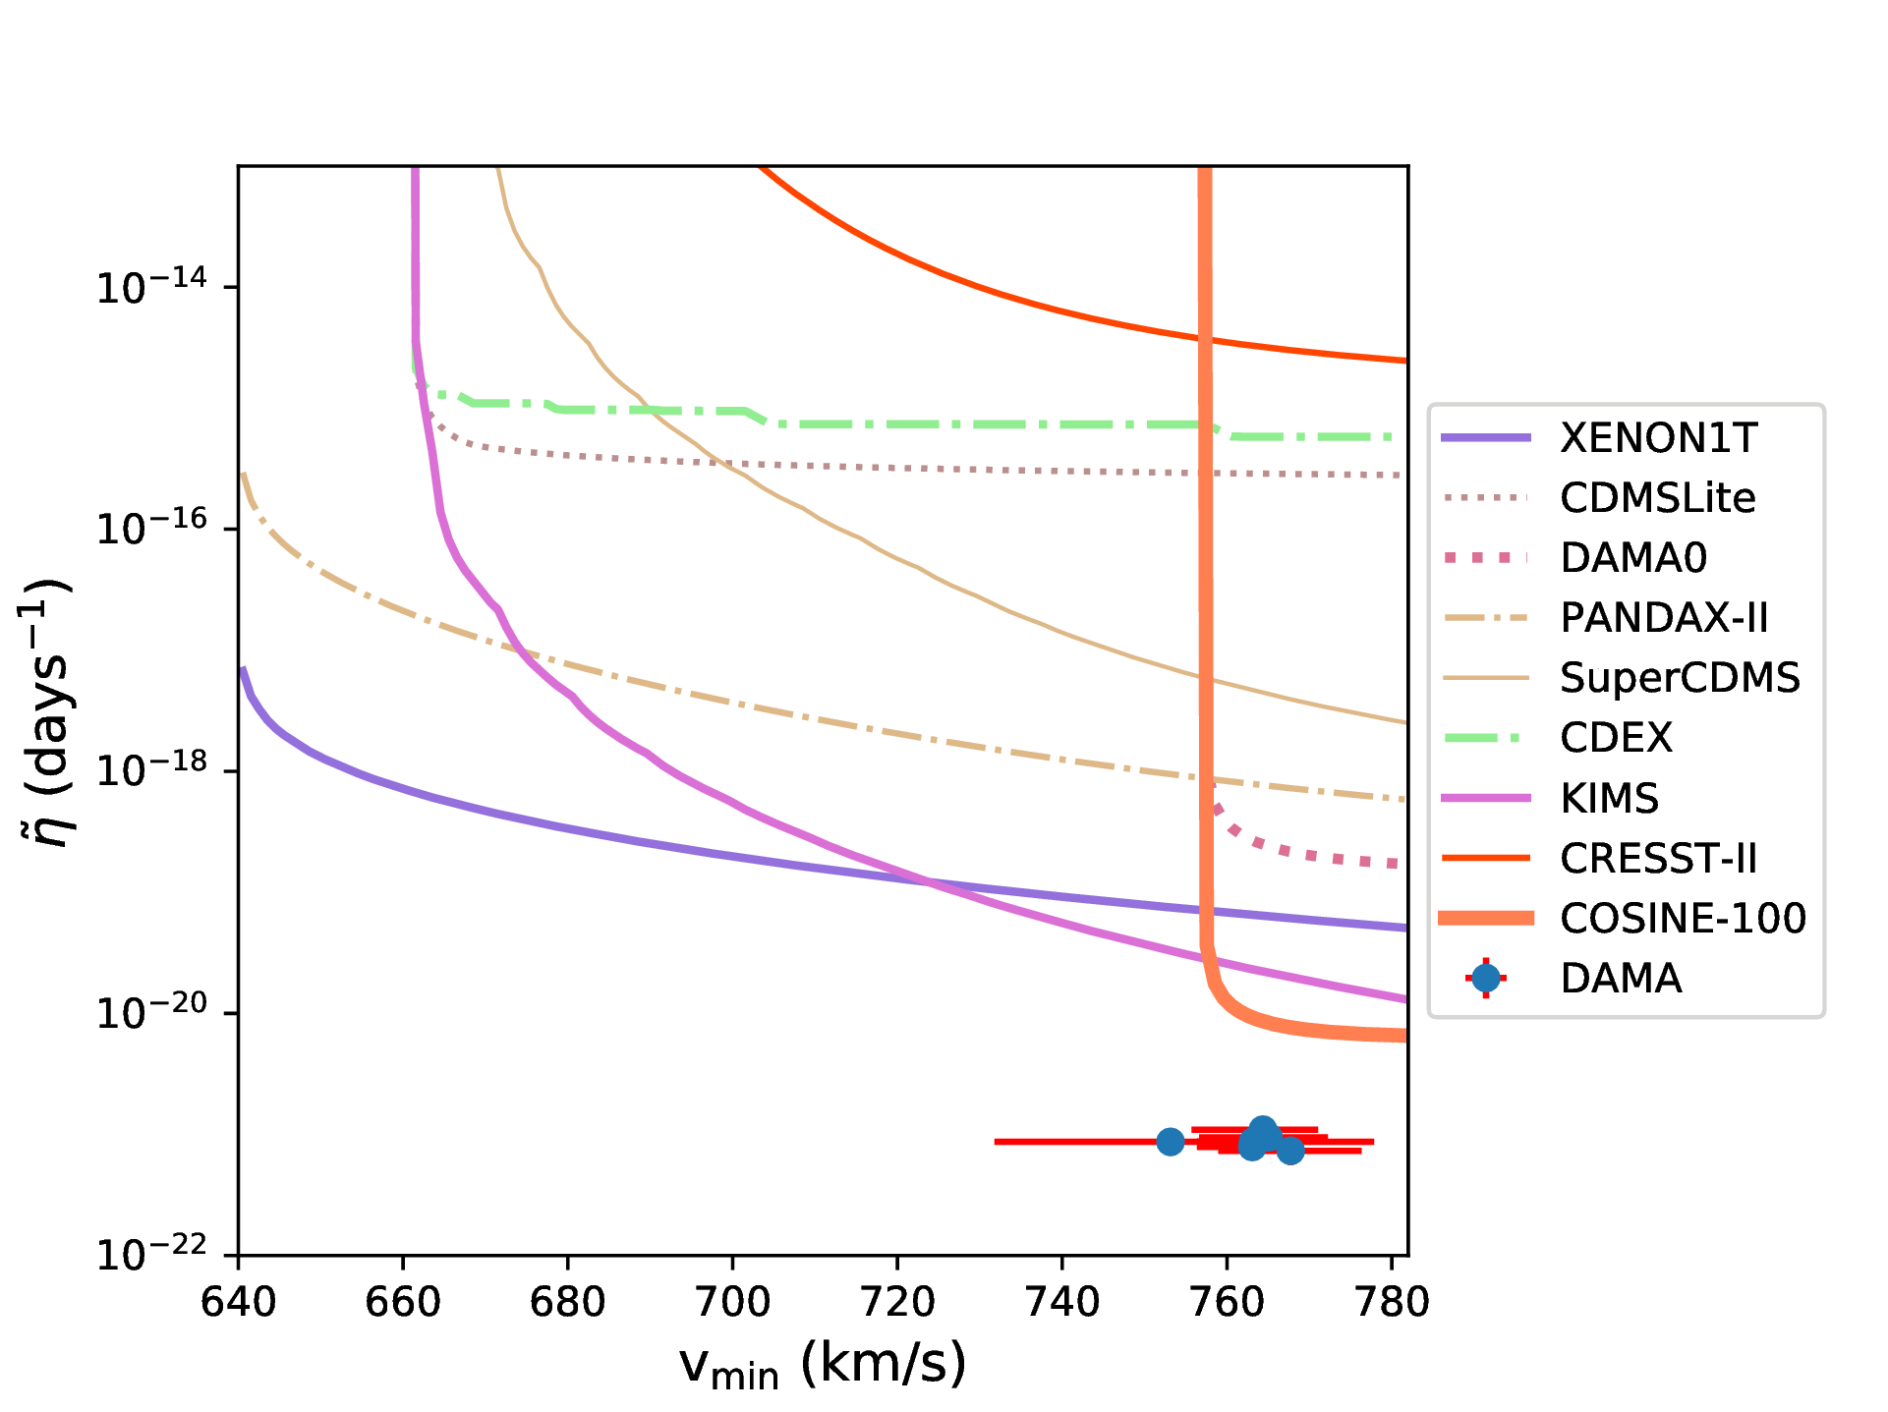
pSIDM
Halo independent case
Sunghyun Kang et al., Proton-philic spin-dependent inelastic Dark Matter (pSIDM) as a viable explanation of DAMA/LIBRA-phase2, 10.1103/PhysRevD.99.023017

Slide 17
pSIDM
COSINE experiment uses same NaI target of DAMA
COSINE-100 does not exclude the pSIDM scenario
$S_{m}^{DAMA} ≅0.02$ events/kg/day/keVee
$S_{0}^{COSINE} ≤0.$13 events/kg/day/keVee
$\frac{S_{m}^{DAMA}}{S_{0}^{DAMA}}=\frac{S_{m}^{DAMA}}{S_{0}^{COSINE}}×\frac{S_{0}^{COSINE}}{S_{0}^{DAMA}}≥0.12$
SI case : $\frac{S_{m}^{DAMA}}{S_{0}^{DAMA}}<0.12$, pSIDM scenario : $\frac{S_{m}^{DAMA}}{S_{0}^{DAMA}}$ > 0.12
Sunghyun Kang et al., Proton-philic spin-dependent inelastic Dark Matter (pSIDM) as a viable explanation of DAMA/LIBRA-phase2, 10.1103/PhysRevD.99.023017

Slide 18
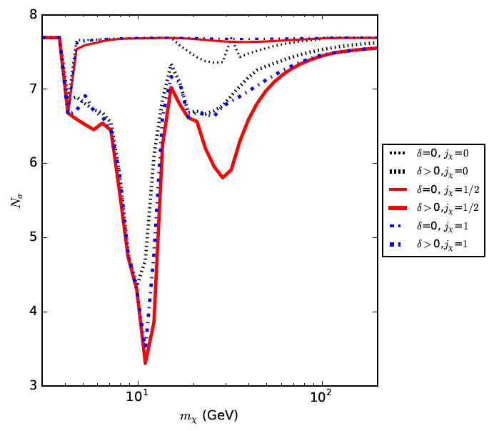
TEASER
TEASER
DAMA interpretation for Inelastic Dark Matter in the full parameter space of non-relativistic effective theory
(8 dimensions for DM spin 0, 28 dimensions for spin ½, 20 dimensions for spin 20, all interferences included)
Maxwellian velocity distribution
Tension in sigmas between DAMA and constraints (ARBITRARY SCALE)
Elastic DM
(large tension)
Also in the full NR effective theory parameter space Inelastic scattering reduces the tension between DAMA and other constraints
Is it enough?
Which combinations of NR operators reproduce DAMA in a better way?
STAY TUNED!
PRELIMINARY
Inelastic DM
(tension drops!)
Kang, Scopel, Tomar, in preparation

Slide 19
Conclusions
non-relativistic effective models can fit the DAMA/LIBRA-phase2 data with less fine tuning compared to a standard SI interaction - all model excluded by fluorine&xenon detectors
pSIDM could explain DAMA/LIBRA-phase1 in compliance with constraints from other experiments. Still OK after DAMA/LIBRA-phase2 if WIMP velocity distribution departs from a Maxwellian.
COSINE-100 bound is naturally evaded in the pSIDM scenario due to its large expected modulation fractions.

